Slide 1
EDCAP Counselor Training 2021 Module 9: Student Loan Sessions and the FSA Website
EDCAP Volunteer Program Training​
Date of Presentation: Monday, Nov 15th , 2021
Presenters: Courtney Davis and Nancy Nierman

Slide 2
Agenda
The Federal Student Aid Website
Doing Research
FSA ID
My Aid
What Information to Gather from FSA Records
Student Loan Simulator
Other FSA Website Tools:
PSLF Help Tool
Forms Center
Submitting a Complaint

Slide 3
The Federal Student Aid Website
https://studentaid.gov/

Slide 4
Federal Student Aid
Find session tools and information on the Department of Education’s Federal Student Aid website at https://studentaid.gov/
The site can be easily navigated or logged in using the horizontal menu at the top of the page.

Slide 5
Student Loan Topic Research
The FSA website contains a large volume of federal aid and student loan program information.
Look up topics by searching through the menu categories or clicking on the search icon to look up by keyword.
DEMO: Sample research questions
I work two part time jobs as an adjunct professor for a public university. Does this qualify for PSLF?
Is it true that drug convictions might affect my ability to get federal student aid?
What PSLF requirements are waived under the Oct. 6, 2021, temporary waiver?

Slide 6
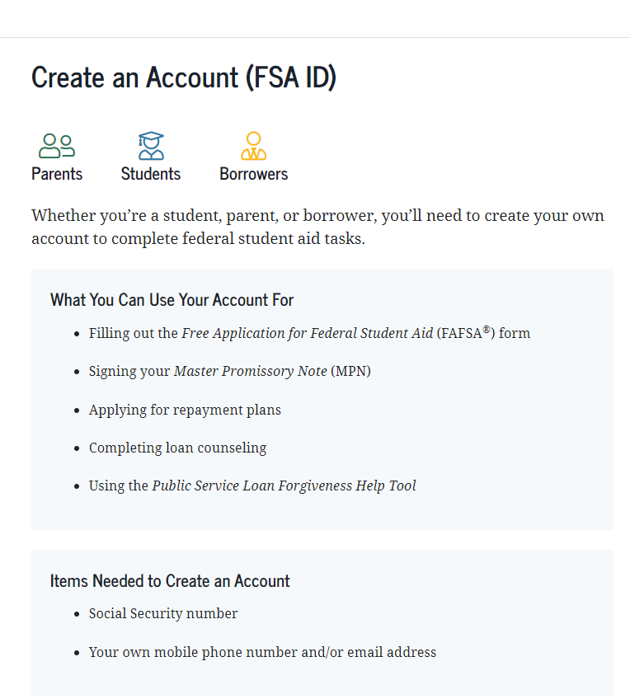
FSA ID
FSA ID is the username and password used to log into the FSA account, to view personal student aid records, and to complete applications online.
If a client does not know their FSA ID you should instruct them to reset their account.
Provide the FSA ID Establish/Reset Checklist.

Slide 7
Create or Re-Establish An FSA ID
Prior to new counseling sessions make sure that your borrower has access to their FSA ID
Test your ID by logging on to your account at Studentaid.gov: https://studentaid.gov/fsa-id/sign-in/landing
To Create an FSA ID, click on “Create An Account” and follow the instructions.
To Re-establish an existing ID, click on either “Forgot my Username” or “Forgot my Password” or both and follow the instructions.
If you have trouble setting up your ID online, call: 1-800-433-3243 for assistance.
Important: In some cases, it can take multiple days for client to access a locked account or to obtain SSA verification for a new account.
Creating or reestablishing the FSA eats up valuable session time, so check in with your borrower before the session to ensure they've tested their account.

Slide 8
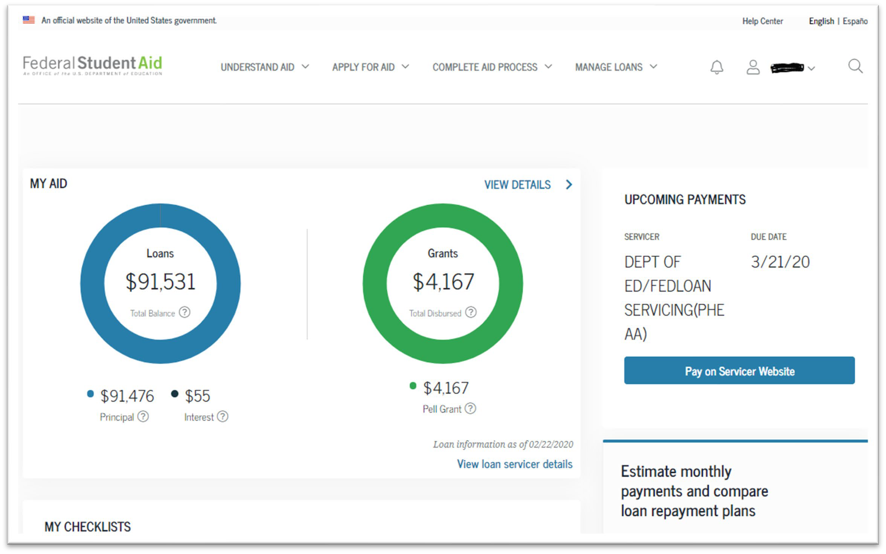
My Aid: Client Dashboard Overview

Slide 9
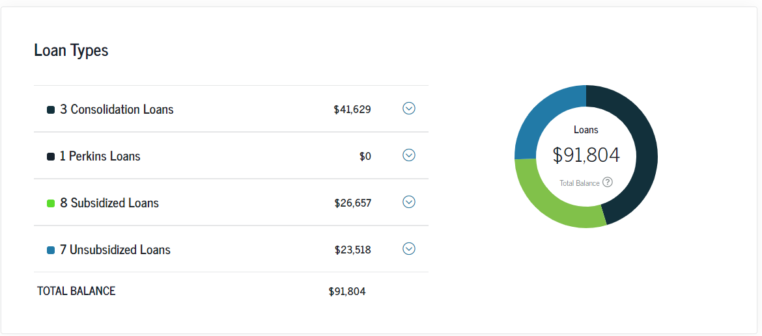
Tip & Reminder: This will give you a big picture of the type of loans the client has but won’t tell you whether they are Direct v. non-Direct (FFEL) loans. You need to click on the dropdown arrows for each category of loans.
Loan Types: Summary
37

Slide 10
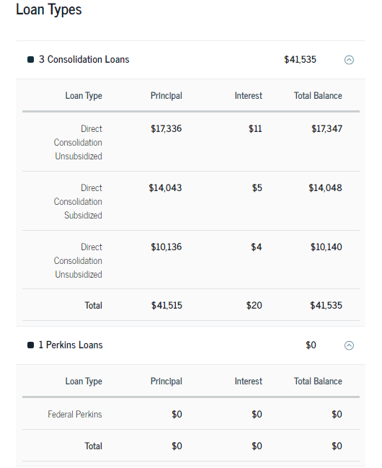
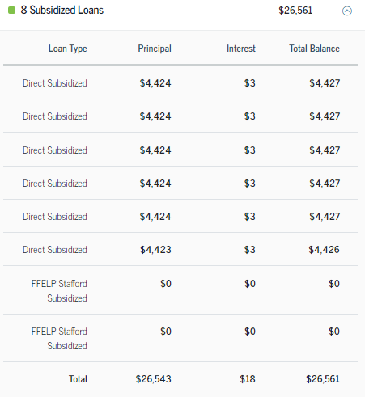
Tip & Reminder: Only “Direct” loans qualify for the Public Service Loan Forgiveness Program. Borrowers who have Perkins or FFELP loans, must consolidate them to make them Direct Loans. But get advice before helping do a consolidation.
Loan Types: Details
37

Slide 11
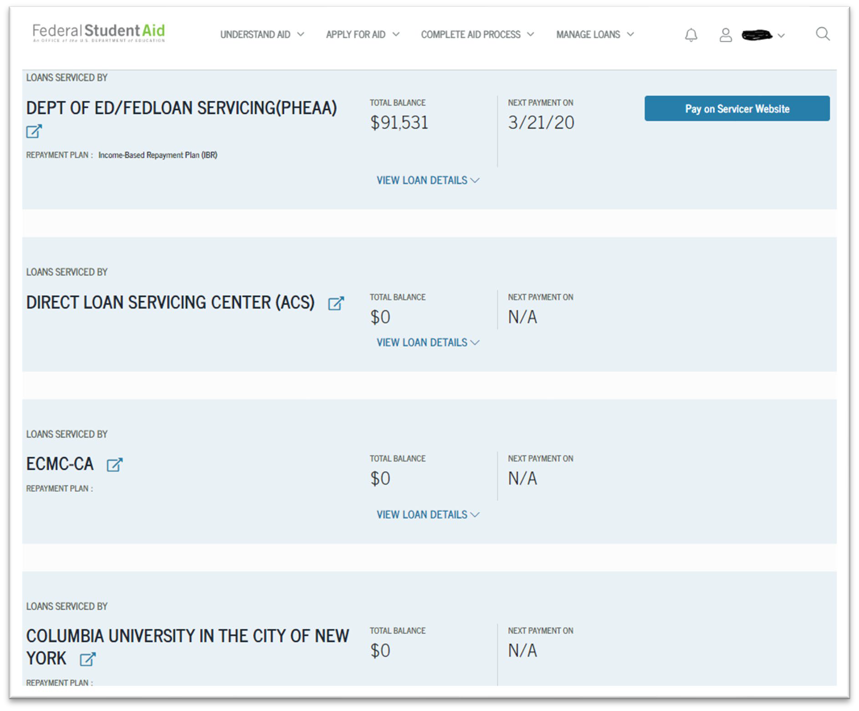
Student Loan Servicer Information
11

Slide 12
Loan Case Notes Example
Client has $91,531 total loan balance.
Direct Consolidation: $41,629
Direct Subsidized: $26,657
Direct Unsubsidized: $23,518
Average interest rate: 5.7% (will expand on this)
Loan servicer: FedLoan
Employment: Works for Nonprofit + pursuing PLSF

Slide 13
Counseling Sessions 101

Slide 14
Pre-Session: Prepare the Client
Send the Intake Form
Send instructions on how to reset the FSA ID
Ask them to have their loan servicer ID available
Ask them to have the Adjusted Gross Income (AGI) from their last filed tax return available. This information can be found as follows:
Line 8b of the 2019 1040 form (To be used if 2020 taxes haven’t been filed)
Line 11 of the 2020 1040 form
List of required information they will need to complete applications (mainly for follow up sessions). This may include things like Consolidations, PSLF Certification & Application Forms, etc.
The more prepared they are, the more efficient your session will be!

Slide 15
Objectives
Determine the current situation
Resolve immediate issues
Clarify short and long-term objectives
Create and implement game plan to achieve objectives
Notes:
Stress the 4th point-Deferment, Forbearance, IDRs,etc… don’t exist for most consumer loans.

Slide 16
Conducting a Session: What you need to know
Federal or Private Loans?
Why is this important?
If the loans are Federal, you can often review options online without having to contact the loan servicer.
If the loans are Private, you will need to look at alternative sources or contact the lender to gather loan information and explore options. Ask the client for the Promissory Note.
If loans are Federal, what kind are they (Direct, FFEL, Perkins, etc.)?
Why is this important?
Knowing the loan type will tell you which repayment plans and forgiveness programs the client may be eligible for.
Notes:
Stress the 4th point-Deferment, Forbearance, IDRs,etc… don’t exist for most consumer loans.

Slide 17
Conducting a Session: What you need to know, (Cont’d)
Is the client currently making payments?
Why is this important?
If yes; what kind of repayment plan are they in? (Standard, IDR).
If they are looking for alternatives, this will point you to plans they are not currently enrolled in.
If no; do they know the loan status? (Deferment, Forbearance, Default).
If they can’t remember when they paid last and don’t know the loan status, chances are they are in default.
How long has the client been paying on their loans?
Why is this important?
This is a key factor in determining whether it makes sense for a client to switch repayment plans or to consolidate.
Notes:
Stress the 4th point-Deferment, Forbearance, IDRs,etc… don’t exist for most consumer loans.

Slide 18
Conducting a Session: What you need to know, (Cont’d)
Personal Information?
Why is this important?
Income levels, family size, marital and tax filing status are key factors in determining which repayment plan is optimal.
The client’s field of employment will determine what kind of loan forgiveness programs they may be eligible for (PSLF, Teacher Forgiveness).
If the client has a disability, they may be eligible for a Total and Permanent Disability Discharge.
Veteran? Special benefits for veterans and those in active service.
Repayment Objectives?
Why is this important?
Paying the loan off as quickly as possible, having low monthly payments or paying as little as possible over the life of the loan will determine which repayment plan is most appropriate and whether to pursue loan forgiveness strategies.
Notes:
Stress the 4th point-Deferment, Forbearance, IDRs,etc… don’t exist for most consumer loans.

Slide 19
Conducting a Session: What you need to know, (Cont’d)
School Experience?
Why is this important?
If the client’s school closed while they were enrolled or shortly after they graduated, they may be eligible for a School Closure Discharge.
If the client feels their school committed fraud, they may be eligible for discharge under the Borrower’s Defense to Repayment.
8) Wage Garnishment, Offsets, Tax Intercepts or Judgements?
Why is this important?
If the client is experiencing one of these, it is an indication loans are in default.
If the client has a wage garnishment consolidation is not an option to cure default and they should pursue rehabilitation if possible,
Notes:
Stress the 4th point-Deferment, Forbearance, IDRs,etc… don’t exist for most consumer loans.

Slide 20
Post-Session: Leave a Roadmap
Summarize topics discussed
Repayment plan options
Forgiveness plan strategy
Disputes/Complaints
List required action steps necessary
Provide supporting information
Links to additional information on the FSA or EDCAP websites
Links to applications
Schedule follow up meetings or note a “check-in” on your calendar if required.
Input Salesforce Data

Slide 21
Using The FSA Simulator

Slide 22
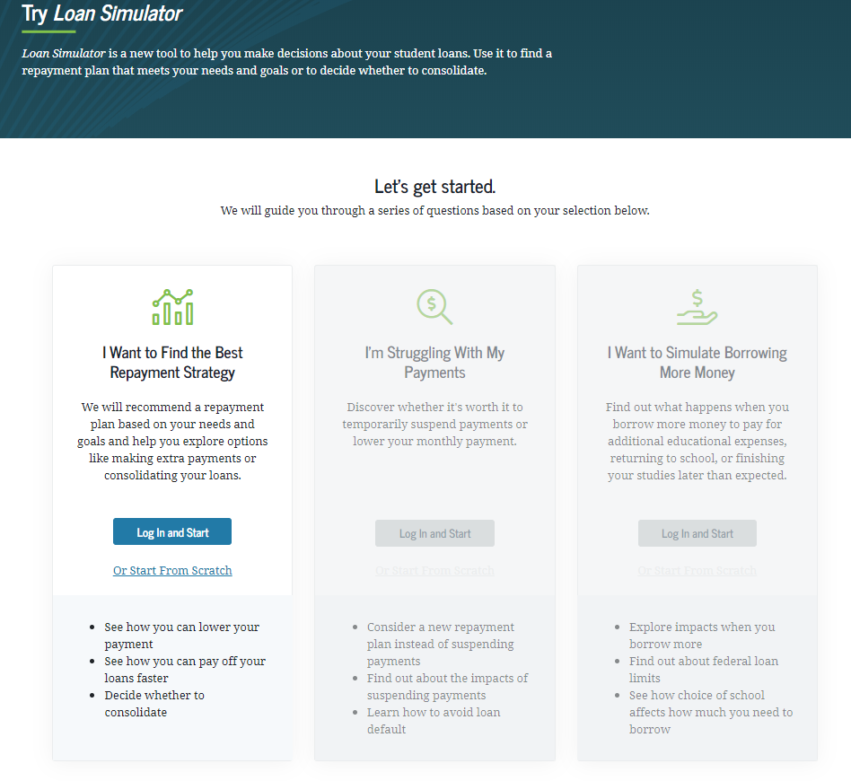
Student Loan Simulator
Login with FSA ID
Or
Use Manually (Start from Scratch)
Notes:
Stress the 4th point-Deferment, Forbearance, IDRs,etc… don’t exist for most consumer loans.

Slide 23
Student Loan Simulator Step 1: Personal Information
Notes:
Stress the 4th point-Deferment, Forbearance, IDRs,etc… don’t exist for most consumer loans.

Slide 24
Student Loan Simulator Step 1: Personal Information, (Cont’d)
Notes:
Stress the 4th point-Deferment, Forbearance, IDRs,etc… don’t exist for most consumer loans.

Slide 25
Student Loan Simulator Step 2: Loan Information
Info will populate automatically if logged into account.
Enter manually if “Starting from Scratch”
Notes:
Stress the 4th point-Deferment, Forbearance, IDRs,etc… don’t exist for most consumer loans.

Slide 26
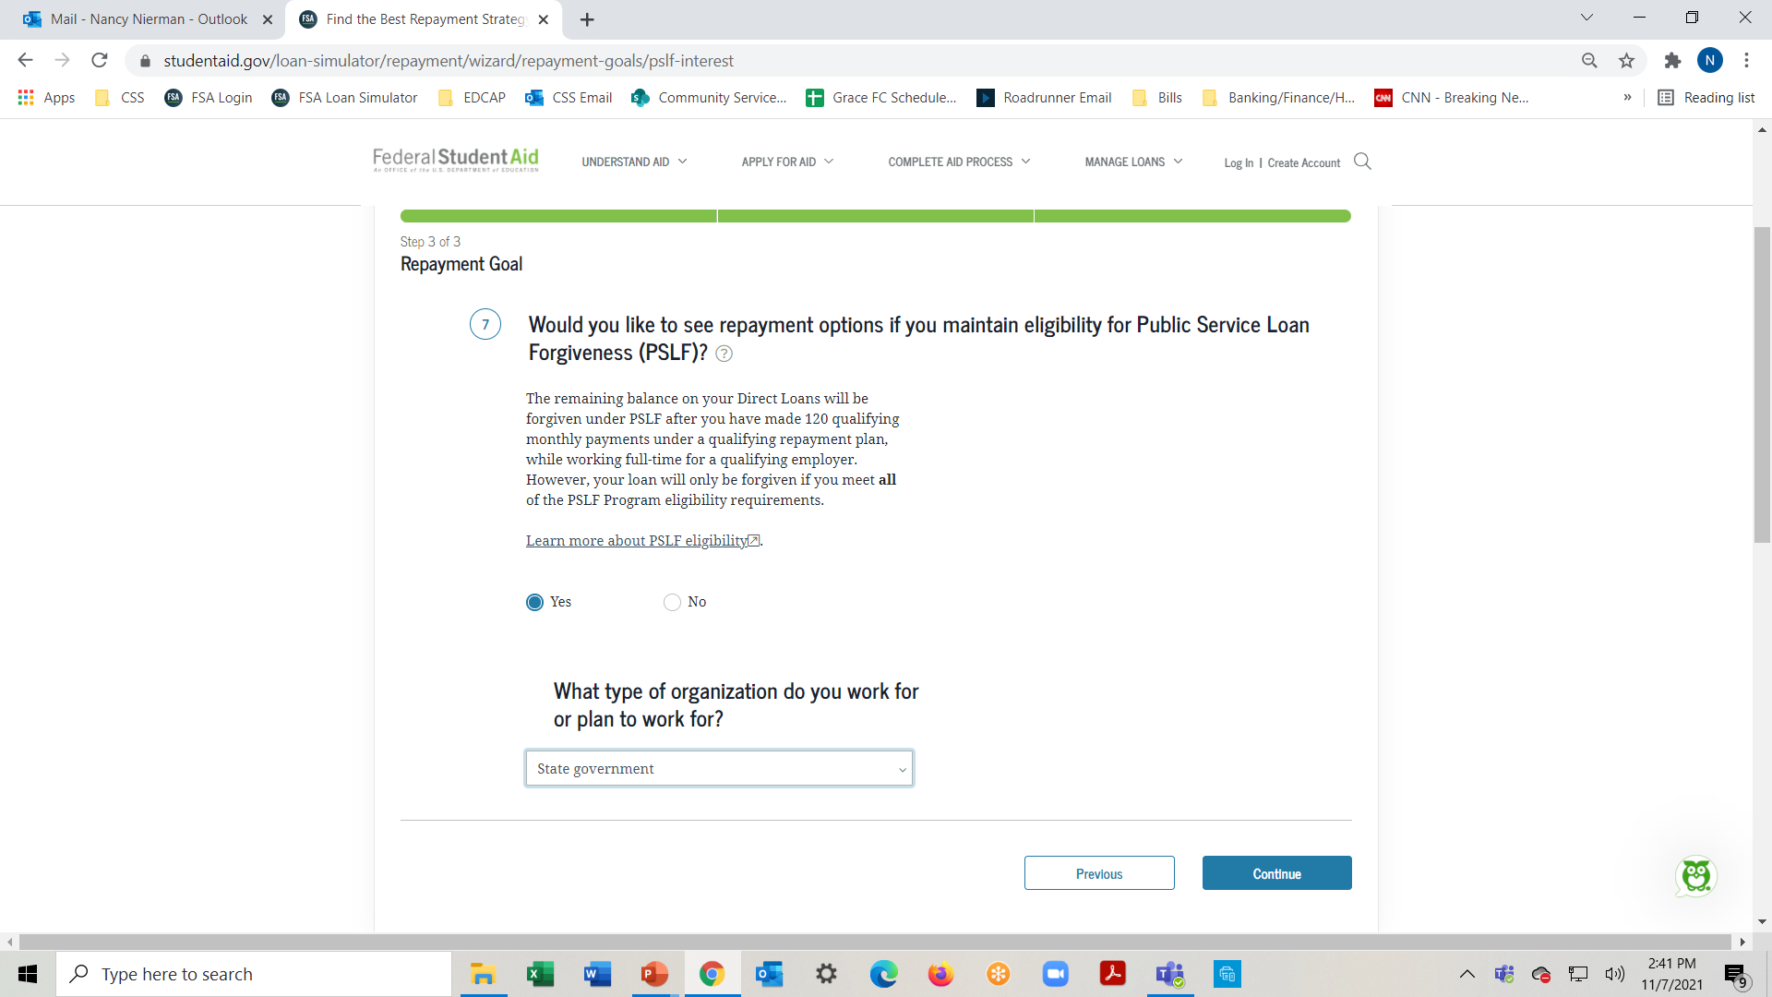
Student Loan Simulator Step 3: Repayment Goal
Notes:
Stress the 4th point-Deferment, Forbearance, IDRs,etc… don’t exist for most consumer loans.

Slide 27
Student Loan Simulator Step 3: Repayment Goal, (Cont’d)
Notes:
Stress the 4th point-Deferment, Forbearance, IDRs,etc… don’t exist for most consumer loans.

Slide 28
Student Loan Simulator Step 4: Review Options
Notes:
Stress the 4th point-Deferment, Forbearance, IDRs,etc… don’t exist for most consumer loans.

Slide 29
Loan Simulation Scenarios
Jamie just graduated from school with student loan debt of $60,000 at an interest rate of 4.53%. She is single and earns $45k/year. Her monthly bill under the 10 Year Standard Fixed Repayment plan is $623 but she is struggling to make that payment. What can Jamie do to ease this burden?
Brendan is 67 and retired two years ago. He is responsible for paying off a $50k Parent Plus loan he took out for his son 6 years ago. The interest rate is 7.08%. His son also pitches in but has his own loans and has had trouble holding down a job. Brendan’s income now consists of social security and a small pension. His adjusted gross income on last year’s tax return was $15,000. What steps can be taken to help Brendan?

Slide 30
Loan Simulation Scenarios, (Cont’d)
Audrey is 30 years old and a single mother of one. She is a social worker at a New York City agency earning $70,000/yr. She has student loan debt of $25,000 with an interest rate of 5.0%. What is the best course of action for Audrey to minimize the amount she will pay over the life of the loan?
What if Audrey’s debt burden was $100,000? ($40,000 undergrad loans at 4.6% and $60,000 graduate plus loans at 7.08%)
Max is married, filing taxes jointly with his wife. He has student loan debt of $80,000 at an interest rate of 6.5%. He had been making $60k/yr but his pay has just been cut in half. His wife makes $75k/yr. He has been enrolled in the REPAYE plan for 6 years, but the payments have risen to over $900/mo. What can Max do to reduce his monthly payment amount?

Slide 31
Loan Simulator: Issues
Running simulator while logged into an account:
Interest rates had been zeroed out in Simulator for most borrowers because of the covid forbearance. Though rates were recently restored, results are not always accurate; particularly for Traditional plans.
You can double check Traditional plan results by running the simulator manually or by using most loan calculators.
IBR Plan:
This plan has two payment schedules; 1) For loans disbursed prior to July 1, 2014, payment is calculated based on 15% of discretionary income, 2) For loans disbursed after July 1,2014, payment is calculated based on 10% of discretionary income.
The calculator won’t always differentiate and often displays only the latter result. If you know your client has older loans you may have to adjust the payment for this plan.

Slide 32
Loan Simulator Issues, (Cont’d)
Consolidation Loans:
Consolidation loans containing Parent Plus loans are only eligible for the Income-Contingent-Repayment (ICR) plan. The simulator doesn’t always pick up on this and may reflect options that are not available to such a borrower.
PAYE Plan:
To be eligible for this plan, a borrower cannot have an outstanding Direct or FFEL loan when they receive a new loan on or after October 1, 2007 and must have a disbursement on or after October 1, 2011. Sometimes, the simulator offers this plan as an option to borrowers who don’t qualify.

Slide 33
Loan Simulator Issues, (Cont’d)
REPAYE Plan:
If you’re married, the payment in this plan is calculated based on the combined income of you and your spouse, regardless of how you file taxes. If the client is married and files taxes separately and you don’t enter the spouse’s income, you will not get the correct result.
If the borrower plans to pursue IDR forgiveness, the repayment period will be 25 years if they have ANY graduate school loans (20 years if they only have undergraduate loans). The simulator often does not reflect the graduate loan scenario and will indicate the loans may be paid off in 20 years instead of 25.

Slide 34
Additional FSA Website Tools

Slide 35
PSLF Help Tool
https://studentaid.gov/pslf/

Slide 36
PSLF Help Tool (cont.)
Important:
The PSLF Help Tool has not been updated to account for the COVID Forbearance or the Temporary Waiver Opportunity, but it can be used to verify employer eligibility.

Slide 37
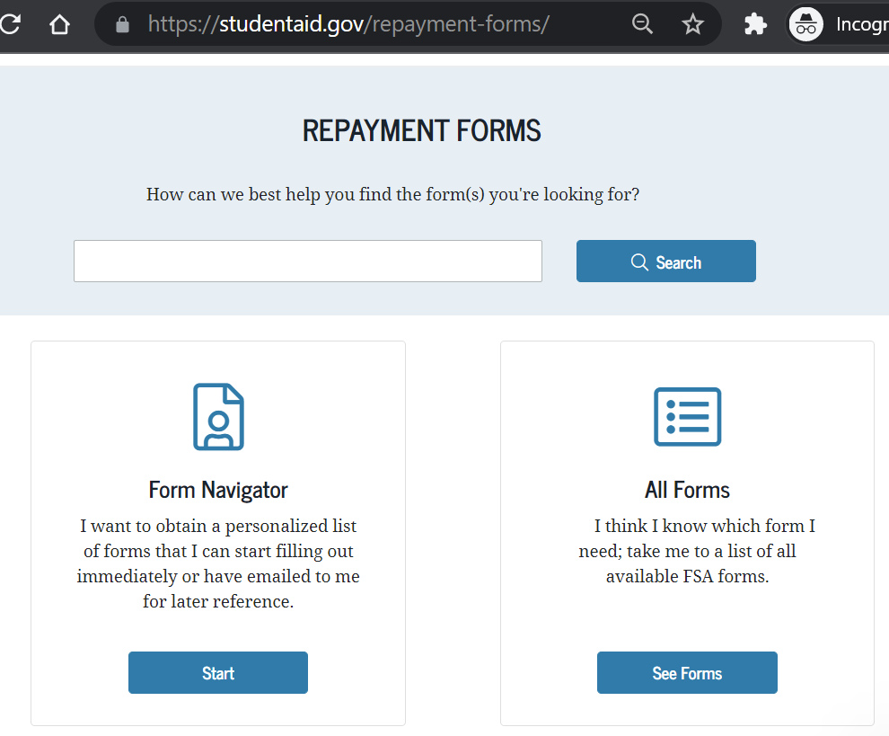
Repayment Forms Menu
Every application used in EDCAP counseling
IDR Repayment
Consolidation
Rehabilitation
Deferment and Forbearance
https://studentaid.gov/repayment-forms/

Slide 38
Important Repayment Forms (Applications)
The full pdf versions of these applications contain official Dept. of Ed instructions and glossaries for the program at hand.
In addition to the applications themselves, the forms contain valuable resource information and instructions about the program.
IDR Repayment and Recertification
Direct Loan Consolidation
Deferment and Forbearance (various)
Public Service Loan Forgiveness (Certification and Application)
Total and Permanent Disability Discharge
Loan Rehabilitation: Income and Expense

Slide 39
Form Example: Rehabilitation
The Loan Rehabilitation: Income and Expense form can be used to calculate a reasonable and affordable rehabilitation payment.
To rehabilitate a defaulted loan, you must agree in writing to make nine voluntary, reasonable, and affordable monthly payments (as determined by your loan holder) within 20 days of the due date and make all nine payments during a period of 10 consecutive months.
Since reasonable and affordable is a relative definition, the Dept. of Ed allows borrowers to submit income and expense information to the collector during the negotiation process.

Slide 40
Commonly Used Online Applications

Slide 41
FSA Feedback Center

Slide 42
Resolving Issues
Before filing a complaint, make sure to help the borrower contact their student loan servicer or collector to request assistance with the problem.
If you don’t get a response or get a response you disagree with, you can escalate by filing a complaint to DOE’s Ombudsman Group through their Online Feedback Center by calling 877-557- 2575.
You can also submit a complaint to your servicer and in NYS to the Department of Financial Services: dfs.ny.gov/complaint.
Contact us! We may be able to help.

