Slide 1
EDCAP Counselor Training 2021 Module 8: Forgiveness & Discharge Programs
EDCAP Volunteer Program Training
Date of Presentation: November 10, 2021
Presenters: Nancy Nierman, Carolina Rodriguez (?) and Courtney Davis

Slide 2
Agenda
Public Service Loan Forgiveness: Original Program & The Temporary Waiver Opportunity
IDR Loan Forgiveness
Other Loan Forgiveness & Discharge Programs
Teacher Loan Forgiveness (TLF)
Total and Permanent Disability (TPD) Discharge
Other Forgiveness & Discharge Programs
Legal Issues & Bankruptcy
Resources & Additional Information

Slide 3
Public Service Loan Forgiveness:

Slide 4
Public Service Loan Forgiveness:
Program History

Slide 5
Public Service Loan Forgiveness (PSLF): Original Program History
PSLF was established on October 1, 2007, to incentivize borrowers pursuing professions that require costly educational credentials to remain in public service jobs where income growth may be limited.
The first applications for loan forgiveness were submitted early 2018. The rejection rate was over 99%.
More recent approval rates are only slightly better at just over 2%.*
Rejections are due to lack of information about program requirements in the early years, poor program administration, and loan servicer errors. Most borrowers rejected because they didn’t have the right loan type or repayment plan.
* Source: Federal Student Aid PSLF Report, April 2021.

Slide 6
Public Service Loan Forgiveness (PSLF): Original Program History, (Cont’d)
Temporary Expanded Public Service Loan Forgiveness (TEPSLF) was introduced in 2018 allowing additional repayment plans to qualify for PSLF.
The program was funded with $350 million and will end when funding runs out. (Through April 2021, about 37% of that funding has been used.*)
The Temporary Waiver Opportunity has made TEPSLF unnecessary for the next year.
The PSLF Temporary Waiver Opportunity was introduced on October 06, 2021. It will relax some program requirements through 10/31/2022. It is being done as part of the COVID emergency relief response.
U.S. DOE is also going through the Negotiated Rulemaking process and may be able to implement more permanent changes to the program. Stay tuned.
* Source: Federal Student Aid PSLF Report, April 2021.

Slide 7
FedLoan Servicing Departure

Slide 8
FedLoan Servicing Departure
FedLoan Servicing is currently the sole administrator of the Public Service Loan Forgiveness program.
They announced in July that they will not renew their contract with the U.S. Department of Education (DOE) to service federal student loans which is set to expire on December 14th of this year. They service 8.5 million borrowers.
FedLoan borrowers will see their loans transferred over the coming months.
It is expected that borrowers pursuing PSLF will be transferred to the same servicer v. borrowers who are not.
The new PSLF servicer has not been announced yet.

Slide 9
PSLF: The Original Program & Temporary Waiver Opportunity

Slide 10
In General
PSLF forgives loan balances for borrowers working for eligible public service organizations after making 120 qualifying monthly payments (10 Years).
You do not “enroll” in the PSLF program. You accumulate qualifying payments towards forgiveness.
Once you meet the general program eligibility requirements, the main task is tracking payments.
Forgiven loan balances are NOT TAXABLE!

Slide 11
You Must Make 120 Qualifying Payments
For payments to count, under the original program they must be…
Made after October 1, 2007
Toward “Direct” Loans
While enrolled in an Income-Driven-Repayment (IDR) Plan *
While you are working full time
For a qualifying employer
Made on time and in full
* Some payments in the Standard 10-Year Fixed Repayment plan may qualify but you must eventually switch to and remain in an IDR plan for most of the life of the loan.

Slide 12
What is the Public Service Loan Forgiveness Temporary Waiver Opportunity?
On October 6, 2021, the Biden Administration unveiled a plan to temporarily waive key requirements of the Public Service Loan Forgiveness (PSLF) program until October 31, 2022.
The goal is to allow borrowers with previously disqualifying loan types and repayment plans to accumulate credit toward the 120 qualifying payments required to have their loan balances forgiven. Other requirements have been relaxed as well.

Slide 13
How Many Borrowers Will Benefit from the Temporary Waiver Opportunity?
According to the U.S. Department of Education:
Approximately 550,000 people who had previously consolidated loans could get some additional qualifying payment credit toward PSLF. This includes:
Approximately 22,000 borrowers with loans totaling $1.74 billion who will be eligible to have their loans discharged with no further action taken.
An additional 27,000 borrowers with loans totaling $2.82 billion who may be eligible for loan forgiveness after filing PSLF Certification forms.
Only 16,000 borrowers to date have received full loan forgiveness under the PSLF program!

Slide 14
Who Is Eligible for PSLF?
Original Program | Waiver Opportunity
Student borrowers Parent Plus borrowers who convert to Direct Consolidation loans | Student borrowers only

Slide 15
What Type of Loans Qualify?
Original Program | Waiver Opportunity
Only Direct Loans | All federal loans qualify. FFEL, Perkins and other Non-Direct Federal Loans may now qualify if consolidated into Direct Consolidation Loans

Slide 16
What Repayment Plans Qualify?
Original Program | Waiver Opportunity
Income-Driven-Repayment (IDR) and Standard 10-Year Fixed Plan | All Repayment Plans

Slide 17
Repayment Plans
Standard/Traditional Plans: Payments are based on the loan balance, interest rate and payback period. There are fixed and graduated payment options and payback terms range from 10-30 years.
Income-Driven Repayment (IDR) Plans: Payments and payback period are based on your Adjusted Gross Income (AGI), family size, and tax filing status.
Revised Pay As You Earn (REPAYE)
Pay As You Earn (PAYE)
Income Based Repayment (IBR)
Income Contingent Repayment (ICR)
The Standard 10-Year Fixed Repayment Plan is the default plan when you come out of school or a grace period. Some payments in this plan will qualify for the original PSLF program, but you must eventually switch to and remain in an IDR plan for the majority of the 10-Year period.
Note: ALL payment plans are eligible during the Temporary Waiver Opportunity through 10/31/2022.

Slide 18
What Is A Qualifying Employer?
Original Program/Waiver Opportunity (No Changes)
Qualified employers include: Nonprofits: Tax-exempt 501(c)(3) Government: Federal, State, Local, Tribal (may include schools & universities) Peace Corps or AmeriCorps Other types of not-for-profit organizations: If their primary purpose is to provide certain types of qualifying public services (education, healthcare, legal services, etc.) Advocacy groups, political groups, and labor unions are not qualified employers.

Slide 19
What Is The Definition of Working Full-Time?
Original Program/Waiver Opportunity (No Changes)
You must meet your employer’s definition of “full-time” OR work at least 30 hours per week, whichever is greater. If you're employed in more than one qualifying part-time job, you can still meet this requirement by working a combined average of at least 30 hours per week. All part-time jobs must meet the employer eligibility requirements.

Slide 20
What Are On-Time and In Full Payments?
 | Original Program | Waiver Opportunity
On-time | Payments must be made within 15 days of the due date (before or after). | Definition of “on-time” will be relaxed.
In-Full | Required payment amount based on repayment plan. | Definition of “in-full” will be relaxed.

Slide 21
Other Rules
 | Original Program | Waiver Opportunity
Loan Status | Must be “In-Repayment”. Months spent in deferment, non-covid related forbearance or grace period do not count. | Must be “In-Repayment” for most borrowers. Months spent in deferment, non-covid related forbearance or grace period will count for Active-Duty Military only!
 | Suspended payments in the Covid Forbearance from 3/13/2020-1/31/2022 will count for all borrowers who meet other program requirements.

Slide 22
Other Rules, (Cont’d)
 | Original Program | Waiver Opportunity
Direct loans consolidated into Direct Consolidation loans. | Payments do not count. Consolidation resets the qualifying payment count clock. | Payments will count if other program requirements are met.
Employment Status at time of applying for and receiving forgiveness | Must be employed full time by a qualifying employer to get actual forgiveness | Do not have to be employed full time by a qualifying employer when applying for or receiving forgiveness.
Payment Dates | Only payments made on or after October 1, 2007, will count.
Number of Qualifying Payments Required to Achieve Forgiveness | 120

Slide 23
How To Track Qualifying Payments

Slide 24
File the PSLF and TEPSLF Certification and Application Form
File the form annually to track your payments: Click here for form.
Your employer (usually HR) must certify your employment by completing the employer section.
If your loans are currently with FedLoan, you should file the PSLF Certification form now to get an updated count of your qualifying payments.
If your loans are NOT with FedLoan AND you are not requesting a review under the Temporary Waiver Opportunity:
File the form now if you think you are within two years of receiving all 120 qualifying payments. Submit the form to FedLoan.
If you have eight or more years to reach the 120 payments, wait until further guidance.

Slide 25
File the PSLF and TEPSLF Certification and Application Form, (Cont’d)
After submitting the form, you will receive a letter detailing how many qualifying payments you have made or if FedLoan is your servicer, you can track your progress online on your MyFedLoan account .
You will be notified when payments do not qualify and why.
If you do not file the form regularly, when you are ready to apply for PSLF you will have to file a form for each job you have had over the 10-year period you were making payments.

Slide 26
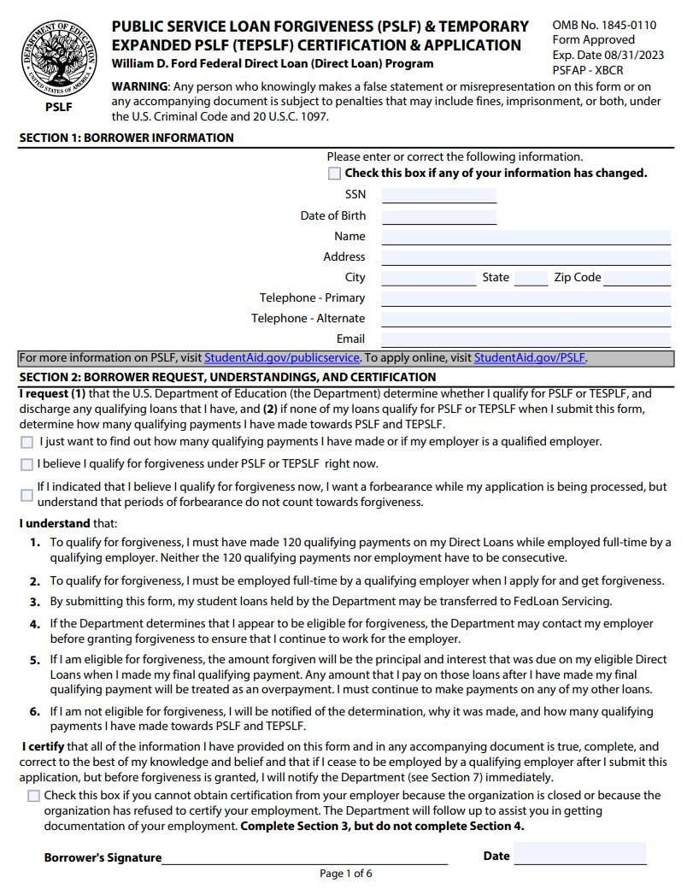
How to Fill Out the PSLF Certification and Application Form
Until applying for forgiveness, you are requesting a count of your eligible payments over different time periods.

Slide 27
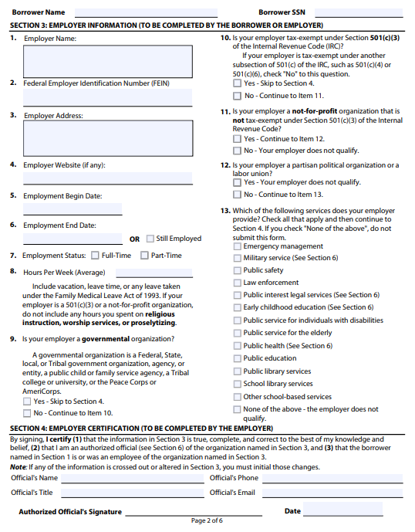
How to Fill Out the PSLF Certification and Application Form, (Cont’d)
The employer will complete this page of the application.
Make sure they enter full employment start and end dates (or check the “Still Employed” box).
Make sure they fill out all items in section 4.

Slide 28
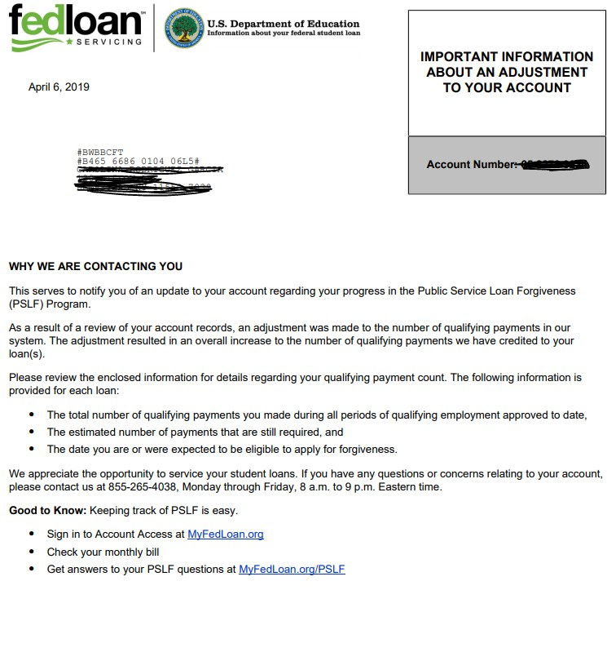
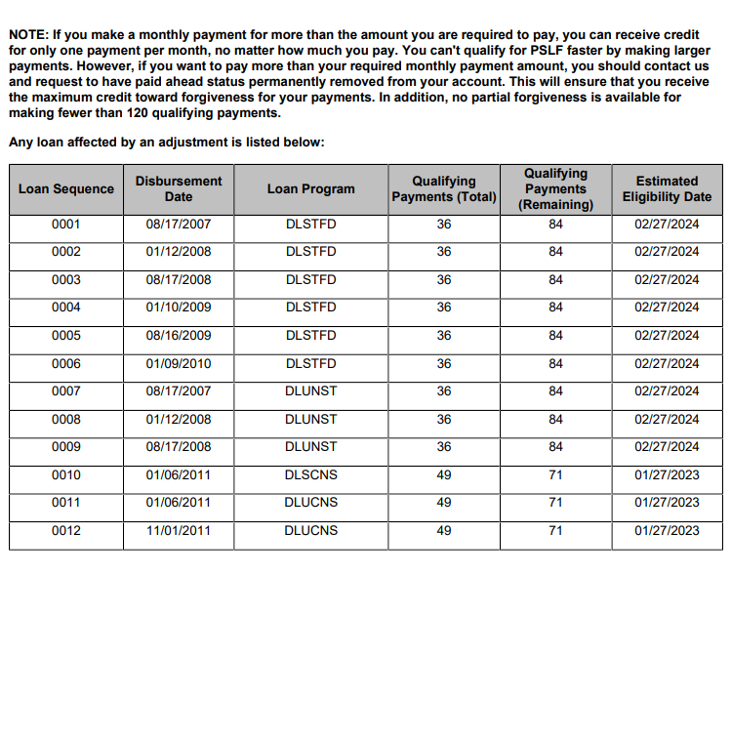
Track Your Progress By Paper

Slide 29
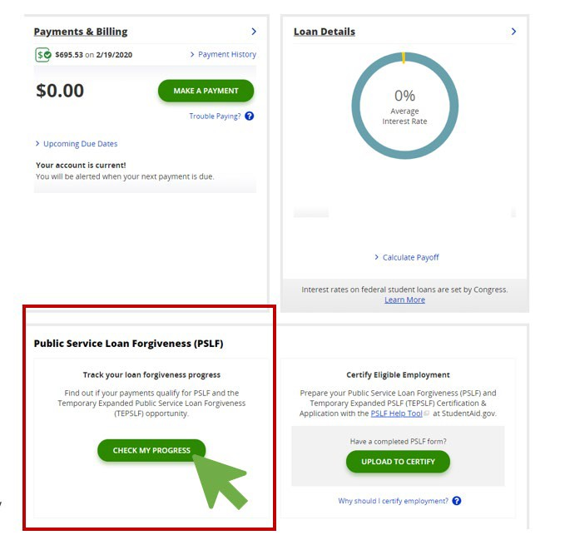
Track Your Progress Online at FedLoan

Slide 30
Track Your Progress Online at FedLoan, (Cont’d)
Eligible payments become “Qualifying” when your PSLF Certification Forms are filed and approved.

Slide 31
Track Your Progress Online at FedLoan, (Cont’d)
You can see why ineligible payments were denied

Slide 32
Do You Have 120 Qualifying Payments?
File the PSLF Certification and Application Form for the final time!
Caution: You must be fully employed at a qualifying employer when you apply for and receive loan forgiveness!
Note: This requirement will be waived for borrowers applying for forgiveness under the Temporary Waiver Opportunity through 10/31/2022.

Slide 33
Required Action:
PSLF Temporary Waiver Opportunity

Slide 34
First Steps
Verify employer eligibility through the PSLF Help Tool on the FSA website (login with the FSA ID).
Verify loan types by logging into the Federal Student Aid (FSA) account at studentaid.gov using the FSA ID.
Take action if necessary.
Caution: The PSLF Help Tool has not been updated to account for the COVID Forbearance or the Temporary Waiver Opportunity but it can be used to verify employer eligibility.

Slide 35
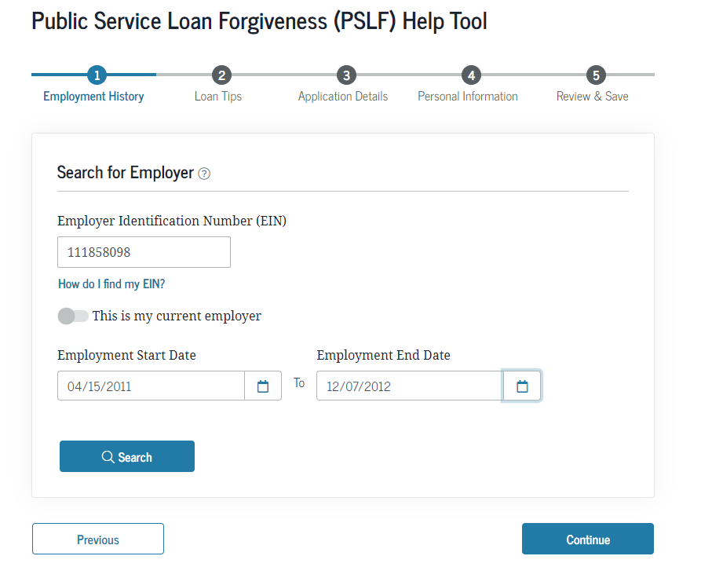
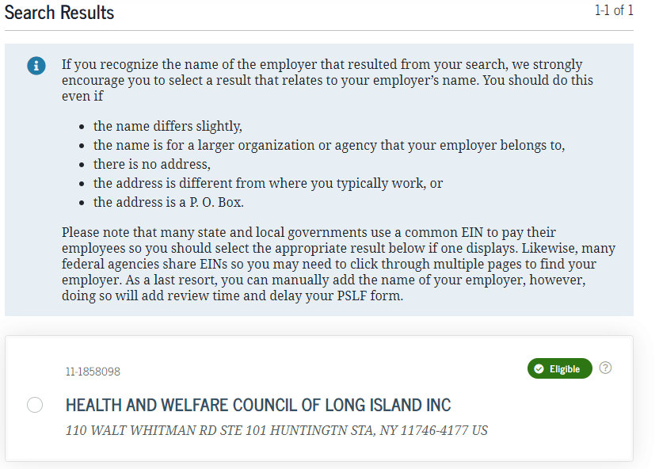
Confirm Employer Eligibility
If you know your employer qualifies, skip the following steps.
Make a list of employers you’ve worked for since October 1, 2007
Get their Employment Identification Number (EIN) and employment dates
Go to the PSLF Help Tool: studentaid.gov/pslf/
Log In using your FSA ID
Follow the instructions for each employer + click search and note whether it is an “Eligible” employer
Caution: The PSLF Help Tool has not been updated to account for the COVID Forbearance or the Temporary Waiver Opportunity, but it can be used to verify employer eligibility.

Slide 36
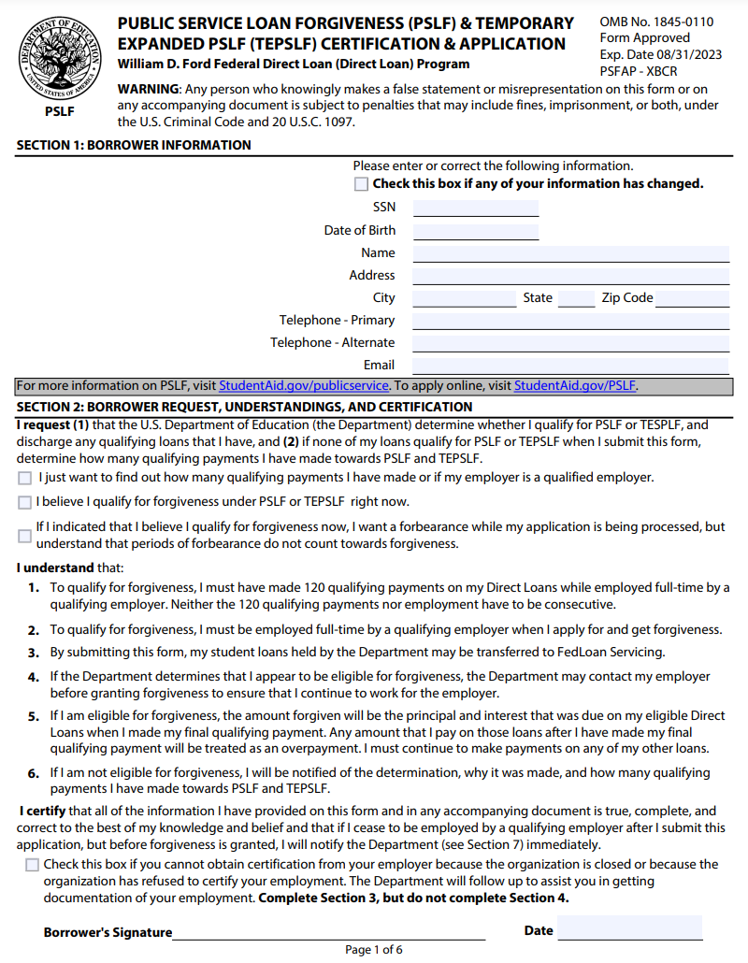
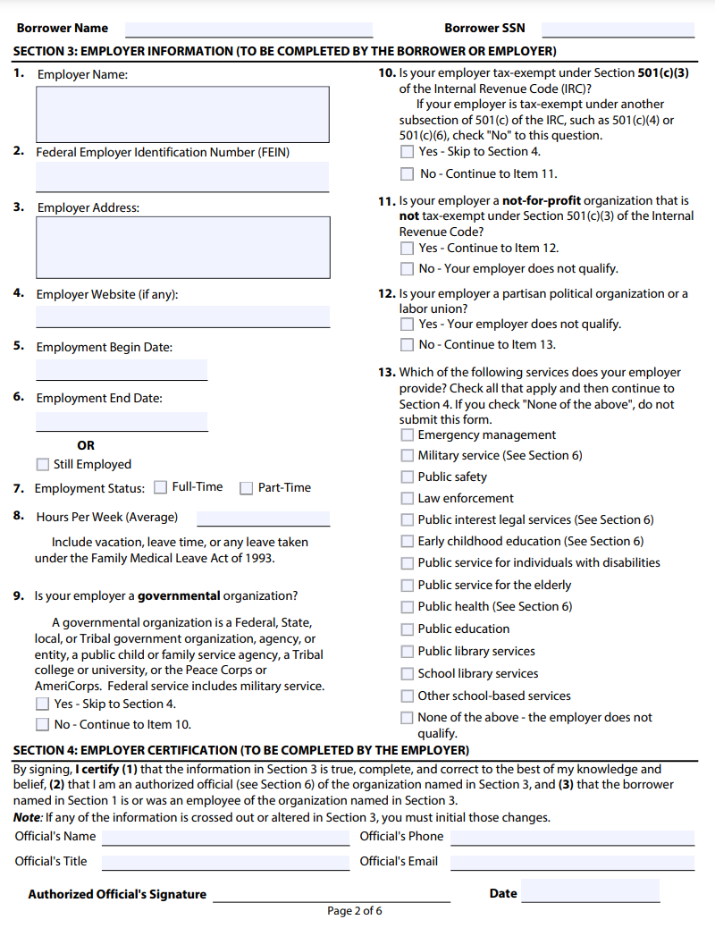
PSLF Help Tool
If you use the PSLF Help Tool, it will auto-populate the information on this form. You sign the first page and your employer signs the second page.
The PSLF Help Tool does not send the application anywhere. You must print it and upload or mail the completed & signed form to the appropriate servicer!

Slide 37
Determine Your Loan Types + Servicer
Go to studentaid.gov
Log In using your Federal Student Aid ID
Click on “View Details”
Scroll down to “Loan Types” and click on the drop-down arrow for each type of loan.
Write down your type(s) of Loans (that have an outstanding balance):
Direct (Subsidized/Usubsidized/Consolidation)
FFELP (Subsidized/Unsubsidized/Consolidation)
Perkins
Other
Direct Parent Plus DO NOT qualify for this waiver

Slide 38
Take Action (if necessary)
The information that follows is based on what we know as of today (11/10/2021). U.S. DOE will be issuing additional guidance.
Refer to studentaid.gov (click here) for updated waiver information and FAQ.
If in the process you find out you need to consolidate your loans, you can do that online at studentaid.gov. But consolidation can be tricky.
When in doubt, get help. Contact EDCAP (edcap@cssny.org).

Slide 39
Temporary Waiver Opportunity: Required Actions
Have Direct Loans
Servicer is FedLoan
Have some qualifying payments
No Action Required!
What is required?: You may receive additional credit without taking any action. But you should submit the PSLF Certification and Application Form(s) if you need to update your qualifying payment count.
When to act?: If you need to update your qualifying payment count, or if you are disputing ineligible payments , you should do this ASAP!

Slide 40
Temporary Waiver Opportunity: Required Actions, (Cont’d)
Have Direct Loans
Submit PSLF Certification Forms to FedLoan ASAP!
Have never submitted PSLF Certification Forms
What is required?: You will need to submit the PSLF Certification and Application Form(s) by October 31, 2022. You need to submit one form for each employer you worked for over the period you think you have made qualifying payments. Qualifying payments start October 1, 2007.
When to act?: You can submit the PSLF Certification Form to FedLoan now, even if FedLoan is not your servicer. If the form isn’t processed by the time FedLoan exits the business, it will be forwarded to the new PSLF servicer.

Slide 41
Temporary Waiver Opportunity: Required Actions, (Cont’d)
Have FFEL, Perkins or other Non-Direct Loans
Consolidate then submit PSLF Certification Form(s)
What is required?: You will need to consolidate these loans into a Direct Consolidation Loan first and then submit the PSLF Certification and Application Form(s) by October 31, 2022. You need to submit one form for each employer you worked for over the period you think you have made qualifying payments.
Caution: If you have a mix of Direct and FFEL/Perkins loans, you should probably only consolidate the FFEL/Pekins loans. Leave the Direct Loans as is. See “Possible Consolidation Hurdles” for more detail. Get help if needed!

Slide 42
Possible Consolidation Hurdles
What if I have ONLY FFEL, Perkins or other non-Direct loans?
Consolidate them and select FedLoan as your servicer in the consolidation application until further notice.
What if I have FFEL, Perkins or other non-Direct loans AND Direct loans that are currently at one servicer?
Consolidate ONLY the FFEL, Perkins and other non-Direct loans. It may be best to consolidate them with your current servicer. DO NOT consolidate Direct + Non-Direct loans together unless you get expert advice!
When the consolidation is complete, file the PSLF Certification Form and all your loans will be transferred to the servicer handling PSLF (currently FedLoan).
This will prevent you from having to deal with more than one servicer.
Remember: After consolidating FFEL, Perkins and other non-Direct loans, you must file the PSLF Certification and Application Form. Ask for help! Contact EDCAP.

Slide 43
Does PSLF Make Sense?

Slide 44
Just Because Someone Qualifies Doesn’t Always Mean It’s The Best Strategy
How large is the debt?
The bigger the debt, the more likely you are to benefit from the PSLF program.
What are the earnings prospects?
If you anticipate modest earnings because of the profession you’ve chosen, PSLF may be right for you.
Can someone realistically expect to pay their debt in full in 10 years or less?
If the answer is “no” , PSLF is a good option.
Understanding the size of the debt relative to earnings potential is key! The FSA Loan Simulator can be a useful tool in helping determine this.

Slide 45
Meet Heather…
Federal Student Loans: $80,000 (Rate 6.5%)
Annual Adjusted Gross Income: $45,000
Household Size: 2 (Single mother of 1)
 | Standard Repayment | Pay As You Earn (PAYE)
Monthly Payment (Start) | $908 | $160
Monthly Payment (End) | $908 | $223
Total Paid | $109,006 | $22,696
Paid Off | 10 Years | 10 Years
Forgiveness Amount | $0 | $109,304
PSLF Makes Sense for Heather: She is unlikely to be able to afford the $908 monthly payment under the Standard Plan to pay the loans off in 10 Years.

Slide 46
Meet Jake…
Federal Student Loans: $40,000 (Rate 4.5%)
Annual Adjusted Gross Income: $ 85,000
Household Size: 1
 | Standard Repayment | ICR | REPAYE
Monthly Payment (Start) | $415 | $400 | $549
Monthly Payment (End) | $415 | $409 | $662
Total Paid | $49,746 | $48,521 | $46,392
Paid Off | 10 Years | 10 Years | 6 Years
Forgiveness Amount | $0 | $1,601 | $0
Jake may choose to make higher monthly payments but pay the loans off 4 years early and save money overall. PSLF may not be the best option for him.

Slide 47
Paying Extra When Pursuing PSLF
In most circumstances it does not make sense to pay extra towards the loans when pursuing forgiveness.
The Strategy:
Set the required payment as low as possible
The borrower pays the minimum required until such time as their loan balances are forgiven
But remember: You are not married to a strategy. If circumstances change, so can the strategy!

Slide 48
Public Service Loan Forgiveness:
General Tips & Information

Slide 49
PSLF Tips & Information
You don’t enroll in the PSLF program. You must make 120 qualifying payments to be eligible for forgiveness so know the requirements!
Qualifying payments are cumulative not consecutive. (If you leave a public service job for the private sector then come back, you will not lose the qualifying payments you’d accumulated prior to changing jobs).
You must file separate PSLF Certification Forms for each employer.
Stay in your IDR plan! Suspended payments in periods of deferment or forbearance WON’T COUNT towards PSLF. If you’re struggling, have your IDR plan recalculated at any time to make your payment more affordable.

Slide 50
PSLF Tips & Information, (Cont’d)
Be careful about paying more than the required amount. In the past, this has caused borrowers to lose out on qualifying payments. It is now possible but there are guidelines you must follow.
Don’t rely on the loan servicer to keep an accurate count! Keep copies of your Certification Forms, billing statements and payments.
Refunds Under The Temporary Waiver Opportunity:
If you receive more than 120 qualifying payments on an existing Direct loan, you will get an automatic refund for the amounts paid over the 120 required.
If you have already received loan forgiveness, you are not eligible for a refund.

Slide 51
Income Driven Repayment (IDR) Forgiveness

Slide 52
Income Driven Repayment (IDR) Forgiveness
All IDR plans offer loan forgiveness. You make qualifying payments in a plan for a certain number of years (20-25) and remaining loan balances are forgiven.
There is no employment requirement for this program.
Forgiven balances MAY BE TAXABLE!

Slide 53
Income Driven Repayment (IDR) Forgiveness, (Cont’d)
There is no established tracking mechanism to monitor progress towards forgiveness. You must ask the loan servicer for an up-to-date count.
It can be difficult to get accurate qualifying payment counts toward IDR forgiveness if the borrower has had multiple servicers.
You do not apply for forgiveness. You will be notified when you are within six months of accumulating enough required payments to have your loan balance forgiven.
Only the ICR plan has been around long enough to have borrowers eligible for IDR forgiveness right now.

Slide 54
Qualifying Payment Rules: IDR Forgiveness
Rules for qualifying payments are difficult for borrowers to access:
You must make your required payment in full and on time. (Note: $0 monthly payments DO QUALIFY if that is your required payment).
Suspended payments during periods of forbearance or deferment do not count with the exception of the Covid Forbearance from 3/13/2020-1/31/2022 and periods spent in an Economic Hardship Deferment.
Payments in the 10-Year Standard Fixed Plan qualify but you must switch to an IDR plan at some point.

Slide 55
IDR Forgiveness By Repayment Plan
Plan | Years of Qualifying Payments Required For IDR Forgiveness
Revised Pay As You Earn (REPAYE) | If you only have undergraduate loans: 20 If you have any graduate loans: 25
Pay As You Earn (PAYE) | 20
Income Based Repayment (IBR) | If you only have loans disbursed after July 1, 2014: 20 If you have any loans disbursed prior to July 1, 2014: 25
Income Contingent Repayment (ICR) - | 25
You can switch IDR plans and not lose credit toward forgiveness. However, the pay-in period of the original plan will remain the same (i.e., if you start in the ICR plan but switch to PAYE, your pay-in period will still be 25 years).

Slide 56
Other Forgiveness and Discharge Programs

Slide 57
Teacher Loan Forgiveness (TLF)
You have Direct or FFEL Loans. A portion or all of a Consolidation Loan may qualify as well.
You teach full-time for five complete and consecutive academic years
You are a “highly qualified” teacher
In a low-income school or educational service agency (Search the Teacher Cancellation Low Income (TCLI) Database to see if the school qualifies)
And meet certain other requirements
Math, Science & Special Education Teachers: Eligible for up to $17,500 of forgiveness
All Other Teachers: Eligible for $5,000 of forgiveness

Slide 58
Teacher Loan Forgiveness (TLF), (Cont’d)
Plus loans for parents or graduate or professional students ARE NOT eligible for the Teacher Loan Forgiveness program.
Federal Perkins loans ARE NOT eligible for the Teacher Loan Forgiveness program but may be eligible for Perkins Loans cancellation or discharge.
You can receive both TLF and PSLF but not at the same time. Generally speaking, borrowers with large debt burdens relative to their income are better off pursuing PSLF.
Forgiven balances ARE NOT TAXABLE!

Slide 59
Total and Permanent Disability (TPD) Discharge
Borrowers may have their loans discharged if they can demonstrate a mental or physical disability that prevents them from earning a living.
Three ways to prove TPD
Through the Veteran’s Administration
Through SSDI. The next review of your SSDI benefits must be within 5-7 years.
Through a physician. Must be a medical doctor willing to certify that the condition will end in death, has lasted for a continuous period of 5 years or is expected to last for a continuous period of 5 years.
3-Year Post Monitoring period for those granted TPD through SSDI or a physician may apply. This is currently waived due to COVID and may be eliminated completely.

Slide 60
Other Forgiveness and Discharge Programs
Perkins Loan Cancellation: Forgives debt of borrowers in certain professions.
New York State Forgiveness Programs: Mostly closed now but may re-open after the federal COVID Forbearance ends.
School Closure Discharge: Forgives debt of borrowers whose school has closed while enrolled or within a certain period of withdrawal. Other criteria apply. Direct, FFEL and Perkins loans are eligible.
Borrower Defense to Repayment (BDR): Forgives debt of borrowers who feel they’ve been misled or defrauded by their school. Only Direct loans are eligible.

Slide 61
Legal Issues, Bankruptcy

Slide 62
Legal Issues
Statute of Limitations (SOL): The date after which a creditor cannot take a debtor to court to retrieve payments.
Federal Student loans DO NOT have a Statute of Limitations!
The government can garnish wages, intercept tax refunds and offset benefits such as social security retirement or disability without a court judgement.
The government CANNOT take SSI payments!
Wage garnishment and social security offsets are limited to 15%. Tax refunds may be intercepted in full.

Slide 63
Legal Issues, (Cont’d)
Private Student loans DO have a Statute of Limitations!
Specific SOLs vary by State. You must have the Promissory Note to determine which State’s law applies.
Private lenders must have a court judgement before garnishing wages or seizing assets. (They can garnish up to 25% of your wages).
Private lenders cannot take social security, tax refunds or other public benefits.
For defaulted private loans; be careful not to restart the SOL clock!
Partial settlements can be negotiated if clients have the means to make lump-sum payments. But the loan needs to be in default for a period of time. Lenders will not settle loans in good standing.

Slide 64
Bankruptcy
Student loans, both federal and private, are difficult to discharge in bankruptcy.
Must declare chapter 7 or chapter 13 bankruptcy
Must go through an expensive and lengthy “adversarial proceeding”
Must prove “Undue Hardship” (The Brunner Test):
Will repaying the loan leave you unable to maintain a minimal standard of living?
Will the hardship continue for a significant period of time during the loan repayment period?
Did you make a good-faith effort to repay the loan before declaring bankruptcy?
Congressional action may be required to effect change.

Slide 65
Resources and Additional Information

Slide 66
Loan Servicer Contact Information
Federal Student Loan Servicers | Phone Number | Note
ECSI | 1-866-313-3797
FedLoan Servicing (PHEAA) | 1-800-699-2908 | Exiting federal servicing business
Granite State-GSMR | 1-888-556-0022 | Exiting federal servicing business
Great Lakes Educational Service | 1-800-236-4300
HESC/Edfinancial | 1-855-337-6884
MOHELA | 1-888-866-4352
Navient | 1-800-722-1300 | Exiting federal servicing business
Nelnet | 1-888-486-4722
OSLA Servicing | 1-866-264-9762

Slide 67
Federal Student Aid (FSA)
FSA ID: click here.
Use this link to create a new FSA ID or manage your existing FSA ID:
FSA Home Page: https://studentaid.gov/
View your federal student loan information on this site:
Login with your FSA ID. This brings you to your “Dashboard”
In the “My Aid Box” click on “View Details”
Click “View Breakdown” to get list of loans by servicer
Click “View Loan Details” under each servicer for list of loans by servicer.
Click “View Loan Details” within individual loans for more detailed information including loan type, principal and interest breakdown.
Click “View Loan History” for detailed list of repayment, deferment and forbearance dates.

Slide 68
Additional Links: PSLF
FedLoan Departure (EDCAP One-Pager)
MYFedLoan
Public Service Loan Forgiveness-Original Program
Public Service Loan Forgiveness Temporary Waiver Opportunity:
PSLF Temporary Waiver D.O.E. Fact Sheet
PSLF Temporary Waiver EDCAP One-Pager
PSLF Temporary Waiver FSA
PSLF Certification and Application Form
PSLF Help Tool (FSA)
Temporary Expanded Public Service Loan Forgiveness (TEPSLF)

Slide 69
Additional Links: Other Forgiveness & Discharge Programs
Borrower Defense to Repayment
Closed School Discharge
New York State Loan Forgiveness Programs (HESC)
Perkins Loan Cancellation
Teacher Loan Forgiveness
Teacher Loan Forgiveness Application
Total & Permanent Disability (TPD) Discharge
Total & Permanent Disability (TPD) Application
Total & Permanent Disability (TPD) Discharge 3-Year Monitoring Period

Slide 70
Additional Links: Miscellaneous
Direct Consolidation Loan (DCL) Application (FSA-Online)
Direct Consolidation Loan (DCL) Application (PDF)
EDCAP Website (edcapny.org)
Income-Driven-Repayment (IDR) Plan Request (FSA-Online)
Income-Driven-Repayment (IDR) Plan Request (PDF)
Repayment Plans

