Slide 1
EDCAP Counselor
Training 2021
Module 6: The Student
Loan System
EDCAP Volunteer Program Training​
Date of Presentation: Wednesday, Nov 3,2021​
Presenters: Courtney Davis and Nancy Nierman

Slide 2
Agenda
EDCAP
Student Loan History
Cost of Higher Education in the U.S. & Student Loan Crisis
Higher Education Debt System: The Basics
  Federal Student Loans
  Private Student Loans
  Institutional Debt
Introduction to EDCAP Counseling
  Common Case Scenarios

Slide 3
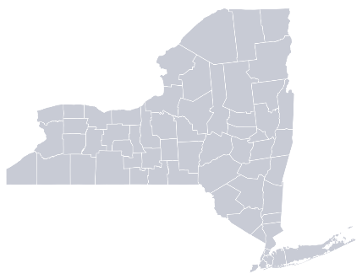
Who We Are
EDCAP is a program initiative of the Community Service Society.
Created to help tackle the student debt crisis in New York.
Offers free and unbiased services.
EDCAP’s goal is to expand statewide.

Slide 4
What We Do
Advise on student loan repayment options.
Rehabilitate loans to help prevent wage garnishments, social. security offsets and tax intercepts.
Apply for loan forgiveness, cancellation and discharge.
Help consolidate loans, request deferments, and forbearances.
Resolve issues with loan servicers and lenders.

Slide 5
History of the U.S.
Student Loan System
1958 - Present

Slide 6
Early History of Student Loans in the U.S.
1958 - First federal student loans made via the Perkins Loan Program via the National Defense Education Act in order to encourage scientific competition with Soviet Union.
1965 – the Higher Education Act creates the U.S. Federal Loan System including: Pell Grants, Stafford Loan Program, and the Federal Family Education Loan Program.
1972 - Sallie Mae is chartered by the federal government to service federal student loans.
1976 – End of bankruptcy protection for federal loan borrowers.
1986 – The federal loan consolidation program is created.

Slide 7
The Student Loan Explosion
Mid-1990s to 2004 - Federal education lending explodes, primarily via the FFEL program. Income Contingent Repayment, the first IDR plan is created in 1994.
2004 - Congress terminates the charter of Sallie Mae and the company is fully privatized.
2005 - End of bankruptcy protection for private student loan borrowers.
2007 – Congress creates the Public Service Loan Forgiveness Program and Income Based Repayment.
2010 – The government terminates the FFEL program. The average cost of one year of college has risen 600% since 1980.

Slide 8
Recent Student Loan History
2013 – Total U.S. student loan debt crosses the $1 trillion mark.
2012 to 2014 - The Pay as You Earn (PAYE) and the Revised Pay as You Earn (REPAYE) income driven repayment plans are created.
2014 – Navient (federal loan servicer) splits off from Sallie Mae.
2017 - The government terminates the Perkins Loan program
March 2020 to January 2022 - Federal student loan borrowers received temporary relief from student loan payments due to COVID.
2021 - Servicers FedLoan, Granite State and Navient announce departure from federal servicing contracts by year’s end. PSLF gets a temporary overhaul.
2022 – Federal loans set to go back into repayment on Jan 31, 2022.

Slide 9
Current Student Loan Debt Stats
Direct Loans $1.1503 trillion 34.2 mil borrowers
FFEL Loans
$281.8 billion
13.5 mil borrowers
The program stopped lending in 2010.
Perkins Loans
$7.1 billion
2.3 mil borrowers
The program stopped lending in 2018.
Total
$1.4392 trillion, 42.9 mil borrowers

Slide 10
Student Loan Crisis in New York
In New York State
  2.4+ million borrowers
  90+ billion owed
  $38,000 average debt
  220,000 older adults carry student debt
  11.6% delinquency rate
In New York City
  1 million borrowers
  Bronx has highest default rate (19%), followed by Brooklyn (15%), Manhattan (12%), Queens (12%), Staten Island (11%)

Slide 11
Cost of Higher Education in the United States

Slide 12
Cost of Attendance (COA)
Colleges calculate COA to show the total cost for the school year.
This amount is always disclosed in an Award Letter, and it is for one year of school only!
Cost of Attendance is NOT JUST TUITION!
  Tuition and Fees
  Room and Board
  Books and Supplies
  Loan Interest and Fees
  Transportation
  Personal Expenses

Slide 13
Undergraduate: Average Cost of Attendance By Sector (2020-21)
 | Sector
 | Public Two-Year | Public 4-Year In-State | Public 4-Year Out-of-State | Private Nonprofit Four-Year | For-Profit
Tuition and Fees | $3,770 | $10,560 | $27,020 | $37,650 | $15,400*
Room and Board | $9,080 | $11,620 | $11,620 | $13,120 | $10,982**
Total | $12,850 | $22,180 | $38,640 | $50,770 | $26,382
Full Time Undergrad Enrollment | 35% | 81% |  | 83% | 67%
Add another $1,500 for books and supplies and $3,000 for other expenses.
*2019-20 (data)
Source: https://research.collegeboard.org/trends/college-pricing; (**) https://research.collegeboard.org/trends/college-pricing

Slide 14
Graduate: Average Cost of Attendance by Sector (2020-21)
 | Public Four-Year |  | Private Nonprofit Four-Year
 | Doctoral | Master’s | Doctoral | Master’s
Tuition and Fees | $11,440 | $8,950 | $44,910 | $29,670
Room and Board | $12,110 | $10,680 | $14,930 | $12,360
Total | $23,550 | $19,630 | $59,840 | $42,030
Fulltime Enrollment | 84% | 76% | 87% | 75%
Add another $1,500 for books and supplies and $3,000 for other expenses.
Source: https://research.collegeboard.org/trends/college-pricing

Slide 15
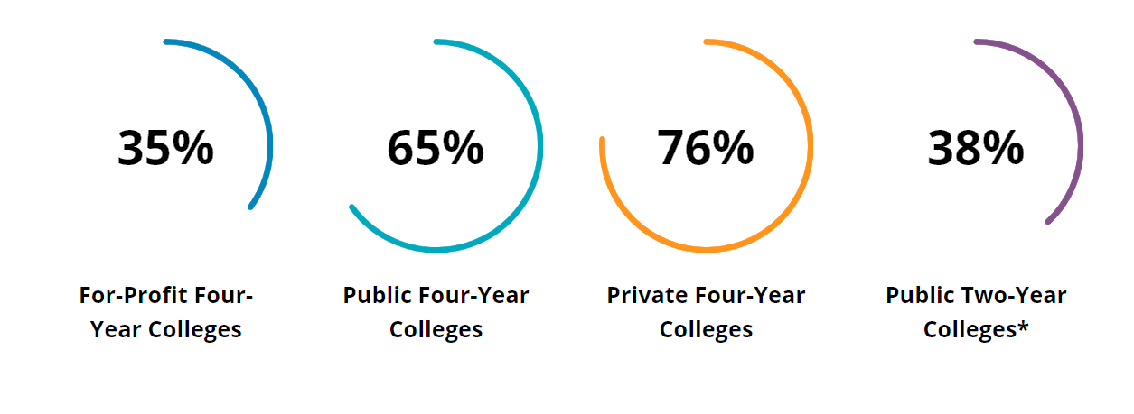
College Completion Rates
On average, 40% of all students who start college will not finish.
Source: https://capseecenter.org/research/by-the-numbers/for-profit-college-infographic/

Slide 16
Sources of Money to Pay for College

Slide 17
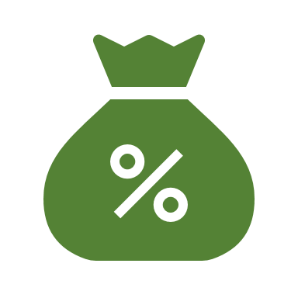
Higher Education Funding Streams
Federal government
State government
Colleges and universities (aka institutional aid)
Private lenders
Employers and private companies
Private foundations, professional and service organizations

Slide 18
Borrowing Limits: Direct Subsidized and Unsubsidized Loans
Dependent undergraduate students
First year | $5,500 overall; $3,500 subsidized
Second year | $6,500 overall; $4,500 subsidized
Third year and up | $7,500 overall; $5,500 subsidized
Total limit | $31,000 overall; $23,000 subsidized
Independent undergraduate students
First year | $9,500 overall; $3,500 subsidized
Second year | $10,500 overall; $4,500 subsidized
Third year and up | $12,500 overall; $5,500 subsidized
Total limit | $57,500 overall; $23,000 subsidized
Graduate and professional students (unsubsidized only)
Annual limit | $20,500
Total limit | $138,500, including undergraduate loans

Slide 19
Borrowing Limits: Direct Plus Loans for Graduates, Professionals and Parents
There are no specific caps on PLUS loan borrowing and credit is considered.
Maximum amount is the school’s cost of attendance minus other financial aid received.
Cost of attendance includes tuition and fees, room and board, and books and other supplies.
Tip: Maxing out federal subsidized and unsubsidized borrowing before tapping PLUS loans is best. PLUS loans will have higher interest rates. Current rate is 6.28%
Caution: Because the limits are high, it is easy to borrow large amounts of Plus Loans.

Slide 20

Borrowing Limits: Private Loans
Limits vary by lender. Typically, it can’t exceed the cost of attendance.
Credit will be considered, which means it will likely require a co-signer.

Slide 21
Federal and State-Based Grants
Federal Pell Grants
  Up to $6,495 per year for award year 2021-2022. (only available to undergraduates and graduate students in a teaching credential program).
Federal Work Study
  Part-time employment opportunities for college students via Federal Work-Study award. In 2021, the average grant was $1,709.
NYS Tuition Assistance Program (TAP):
  State grant of up to $5,665 per year. Must apply through FAFSA and HESC (hesc.ny.gov).
NYS Excelsior Scholarship Award:
  Can receive up to the full tuition costs not covered by other aid programs for eligible students attending CUNY or SUNY schools. Household income must be <$125,000. Recipients must agree to live and work in NY.

Slide 22
Institutional Aid
Colleges and universities have their own scholarships or other forms of aid.
Students may need to meet certain criteria and maintain a specific GPA.
They may also have “discretionary aid,” which they can grant to students with special circumstances.
Students must talk with the school’s financial aid office to see what they can do to lower the cost! All they can say is no.

Slide 23
Private Lenders (CAUTION)
Schools are associated with private lenders that offer loans directly to students. Private lenders are banking or other for-profit institutions.
A credit check will be required which means most younger borrowers will need a co-signer.
Private loans tend to have higher interest rates than federal loans.
Repayment is based on the size of the loan, interest rate and term.
They offer limited repayment options and generally don’t qualify for forgiveness or discharge like federal loans.
Co-signers are 100% responsible for the debt! If the borrower defaults, the co-signer defaults.

Slide 24
Employers and Companies
More companies are willing to help pay for college as a benefit.
Many union jobs will have an education benefit where employees can get an entire degree paid for at a public institution!

Slide 25
Private foundations, professional and service organizations
There are a wide array of private scholarships available for students via private foundations and professional organizations.
FastWeb.com is the largest private scholarship database online.
When students create an account on FastWeb.com, the website can help them use the same information to apply for multiple scholarships.

Slide 26
Accepting Aid (Order of Priority Recap)
Students should read their Financial Aid Award Letter and accept only what they need, in the following order:
  Free money first
    Pell and Other Federal Grants
    TAP, Excelsior and other State Grants
    Institutional Grants and Scholarships
    Private Grants and Scholarships
  Earned money second (federal work-study),
  Subsidized federal student loans third,
  Unsubsidized federal loans fourth,
  Private student loans LAST.

Slide 27
The Higher Education Debt Systems
Loan Programs and Terminology

Slide 28
Federal Student Loans

Slide 29
Federal Student Loans: Pros
Most people are eligible for some form of federal student loans.
Interest rates are not credit-based and tend to be lower than those of private loans.
Interest rates are fixed for the life of the loan and are the same for all loans issued during the same time-frame.
There are options for people who are struggling financially:
    Deferment
    Forbearance
    Income-Driven-Repayment (IDR) Plans
    Plans for curing defaults

Slide 30
Federal Student Loans: Cons
There is no statute of limitations on federal student loan debt.
Extremely difficult to discharge in bankruptcy.
Poor quality of loan servicers can lead to confusion and misinformation.
Benefits of the system (IDR plans, Loan forgiveness) are at the mercy of the U.S. Congress and President.

Slide 31


Student Loan Repayment Process
Deferment or Forbearance
Paid As Agreed
Paid in Full or Forgiven
Loan Issued
(In-School Deferment/Grace Period)
In Repayment
Delinquency (90 days late)
Default (270 days late)
Collections and
Garnishment

Slide 32
Loan Programs
Loan Status
Repayment Plans
Loan Servicer
The William D. Ford Federal Direct Loan Program-Loans come directly from the Federal Government.
  Direct Subsidized Loans-The government covers unpaid interest during certain periods.
  Direct Unsubsidized Loans-The borrower is generally responsible for interest accrued.
  Direct Plus Loans for Graduates and Professionals-only unsubsidized loans available. Credit check required.
  Direct Plus Loans for Parents-Offered to parents of college students. Only unsubsidized loans available. Credit check required.
  Direct Consolidation Loans-Allow borrower to combine loans for ease of administration. Does not lower interest rates.
FEDERAL STUDENT LOANS ARE ONLY OFFERED THROUGH THE DIRECT LOAN PROGRAM TO NEW BORROWERS.

Slide 33
Loan Programs
Loan Status
Repayment Plans
Loan Servicer
These loan programs are no longer available, but borrowers still have these type of loans.
  Federal Family Education Loan (FFEL)-Loans came from banks, guaranteed by the Federal Government.
  Federal Perkins Loans-Federal Government subsidized loans offered to students with great financial need directly through the school.
    These loans will be managed by the higher education institution that granted the Perkins loans, resulting in borrowers having more than one servicer.
FFEL and Perkins don’t qualify for the Public Service Loan Forgiveness but learn about the latest Temporary waiver exception.

Slide 34
Loan Programs
Loan Status
Repayment Plans
Loan Servicer
In School Deferment – While the student in school at least half time. No payment is required.
Grace Period-The six months following graduation, leaving school or dropping below half-time status. No payment is required.
Deferment or Forbearance- Provides temporary relief from payment (up to one year at a time). Generally, no payment is required.
Repayment- Enrolled in a repayment plan and a payment may be required.
Default- Borrower has been delinquent or failed to make payments for at least 270 days. The loans are now payable in full.

Slide 35
Loan Programs
Loan Status
Repayment Plans
Loan Servicer
The Standard Plans: Payments are based on size of loan, interest rate and pre-determined payback period.
Standard Fixed
(10 -30 years)*
Standard Graduated
(10 -30 years)*
Extended Fixed
(Up to 25 years)
Extended Graduated
(Up to 25 years)
Income-Driven-Repayment (IDR) Plans: Payments are based on adjusted gross income and family size. .
Revised Pay As You Earn (REPAYE)
Pay As You Earn (PAYE)
Income Based Repayment (IBR)
For borrowers before July 1,2014
For “New Borrowers” after July 1,2014
Income Contingent Repayment (ICR)

Slide 36
Loan Programs
Loan Status
Repayment Plans
Loan Servicer
Servicer | Phone Number
ECSI | 1-866-313-3797
FedLoan Servicing (PHEAA)** | 1-800-699-2908
Granite State-GSMR** | 1-888-556-0022
Great Lakes Educational Service | 1-800-236-4300
HESC/Edfinancial | 1-855-337-6884
MOHELA | 1-888-866-4352
Navient** | 1-800-722-1300
Nelnet | 1-888-486-4722
OSLA Servicing | 1-866-264-9762
**Indicates servicer is ending contract in 2022

Slide 37
Private Student Loans

Slide 38
Handling Private Student Loans
Unlike federal student loans, private loans are credit based. Eligibility is determined by the financial institution offering the loan.
Interest rates are often higher than federal student loans.
Protections and benefits offered to federal student loans, such as IDR plans, deferments, forbearances, loan forgiveness programs, may not be available to private student loan holders.

Slide 39

Handling Private Student Loans (Cont’d)
READ THE PROMISSORY NOTE!
In NY, the Statute of Limitations is 6 years (from the date of last activity).
Running a credit report may help firm-up this date.
Co-signers beware. You are 100% liable if the primary defaults and Co-signers’ credit will be impacted.
Co-signer releases are up to the lender and are difficult to obtain.

Slide 40
Institutional Debt

Slide 41
Direct to School (Institutional) Debt
Limits vary by the school or program.
Must be repaid based on terms and conditions set by the school. Usually due by the end of the school term.
Transcripts may be withheld if the balance is not paid.
  CUNY suspended the transcript withholding practice for folks impacted by COVID.
Subject to debt collection.
In NYS, the Attorney General will sue on behalf of SUNY to collect.

Slide 42
Common Case Scenarios
An Introduction to EDCAP Counseling

Slide 43
In General
Counseling borrowers on student loan debt typically requires:
  Looking at their actual student loan records (type of loans, loan balance, interest)
    Most borrowers won’t even know if they have federal or private student loans.
    They will confuse their servicer with their lender.
    They may have multiple servicers.
  Using the Student Loan Simulator
    There are multiple repayment options but usually borrowers narrow them down to two options based on their type of loans and objective or circumstances.
  Determining their eligibility for forgiveness, discharge or other programs
    This will help the borrower know what is their ultimate game plan.
  Developing both a short- and long-term solution
  Helping the borrower take action steps to be and remain on the right path!

Slide 44

Whare can you find loan information?
For federal student loans:
  Borrowers can access loans on the FSA Home Page with an FSA ID.
  If they cannot access the loans online, call Federal Student Aid at 1-800-433-3243. They can direct you to the loan servicer or debt collector.
  If the loan is in default or when in doubt, call Default Resolution Group at 1-800-621-3115.
  For private loans:
  Look at credit reports, lender or debt collector correspondence.
  Free weekly credit reports are now available through April 20,2022 on AnnualCreditReport.com.
  For institutional debts:
  School records
  Debt collector notices

Slide 45
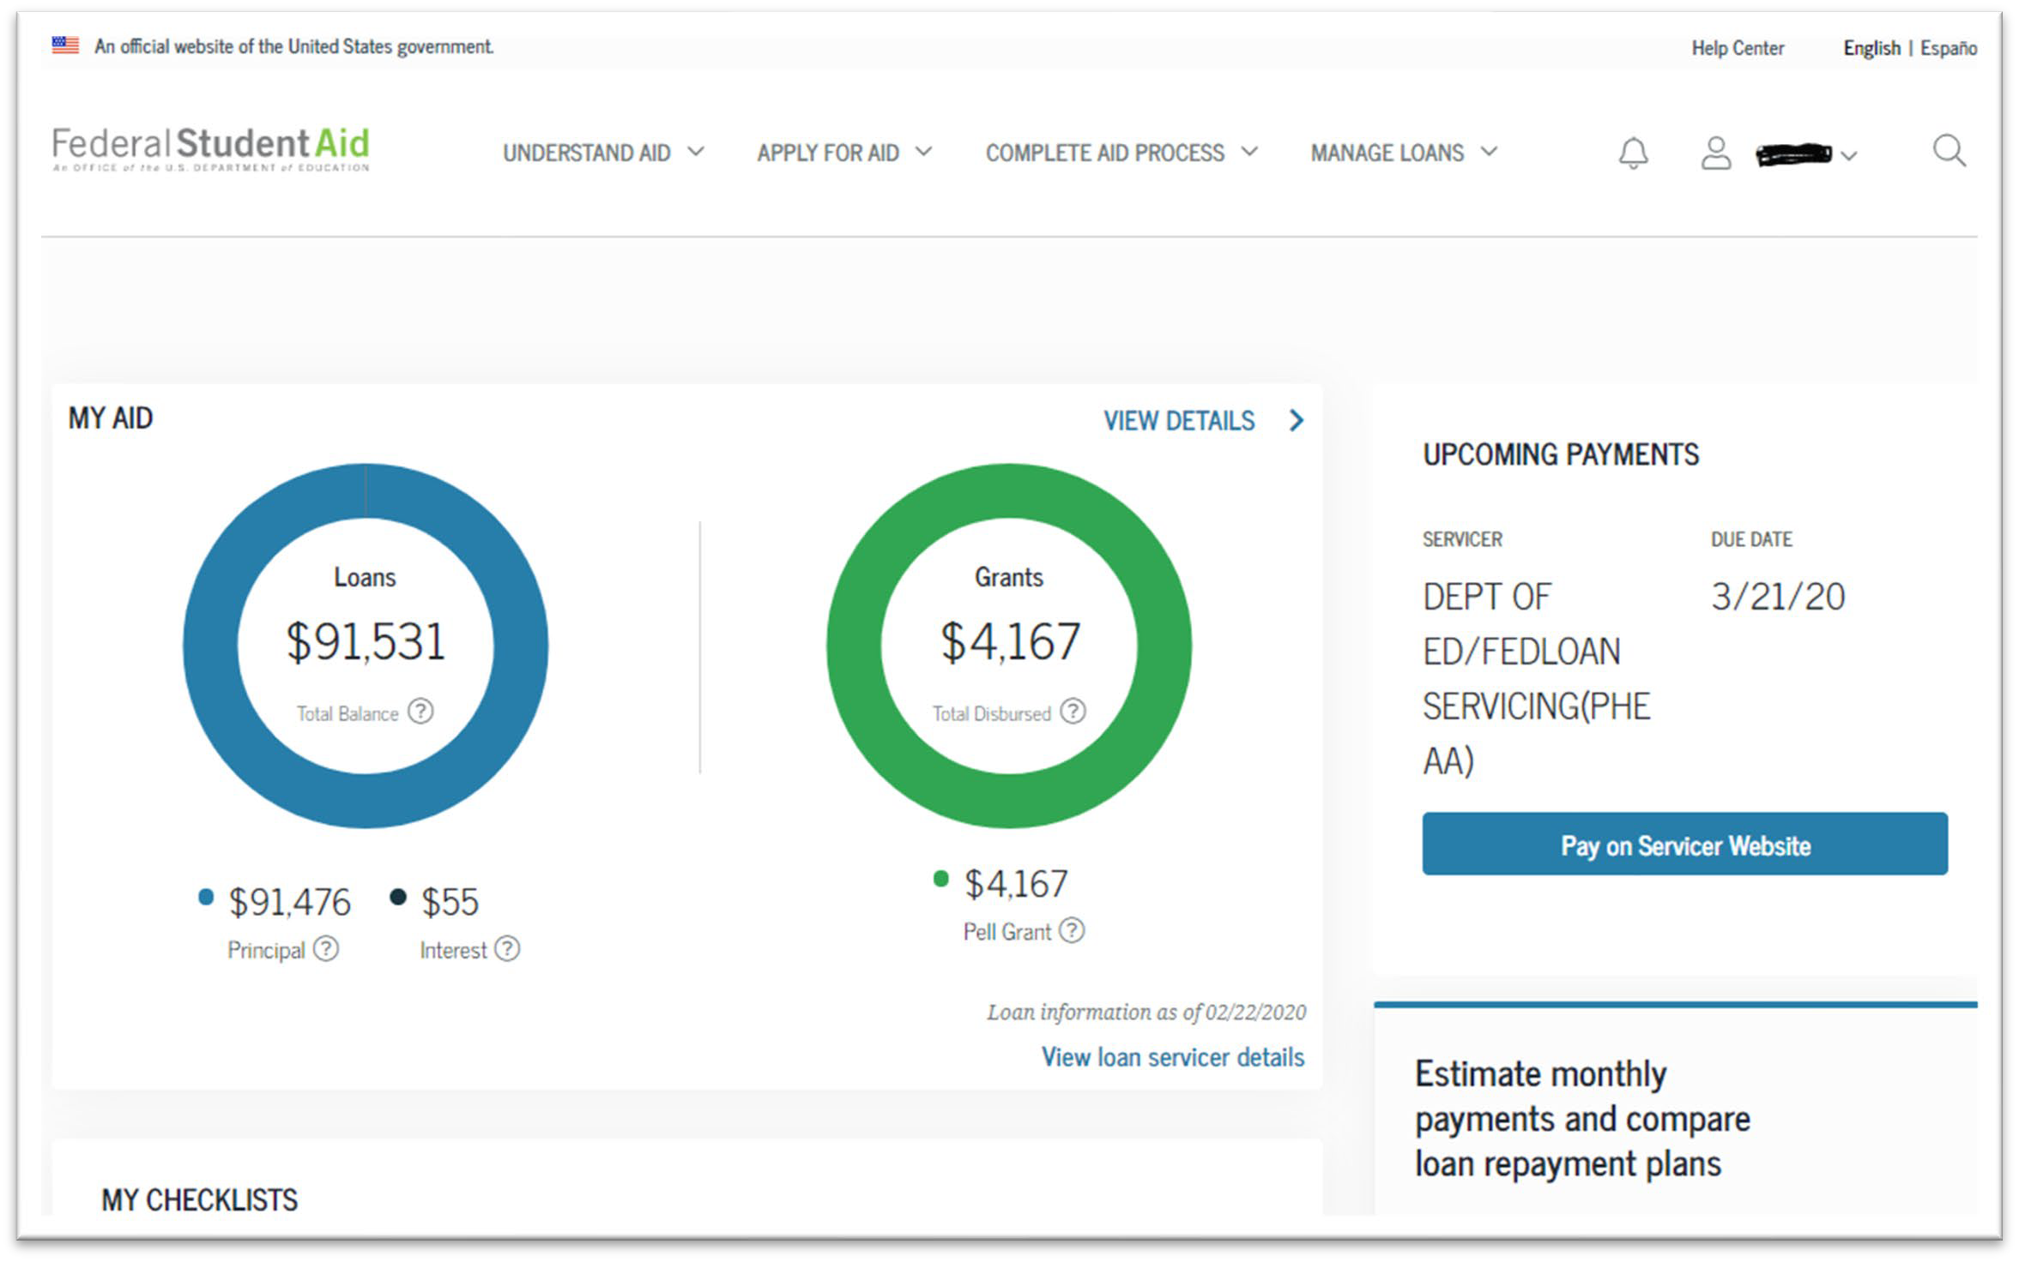
FSA National Federal Student Loan Database (Sample Dashboard)

Slide 46
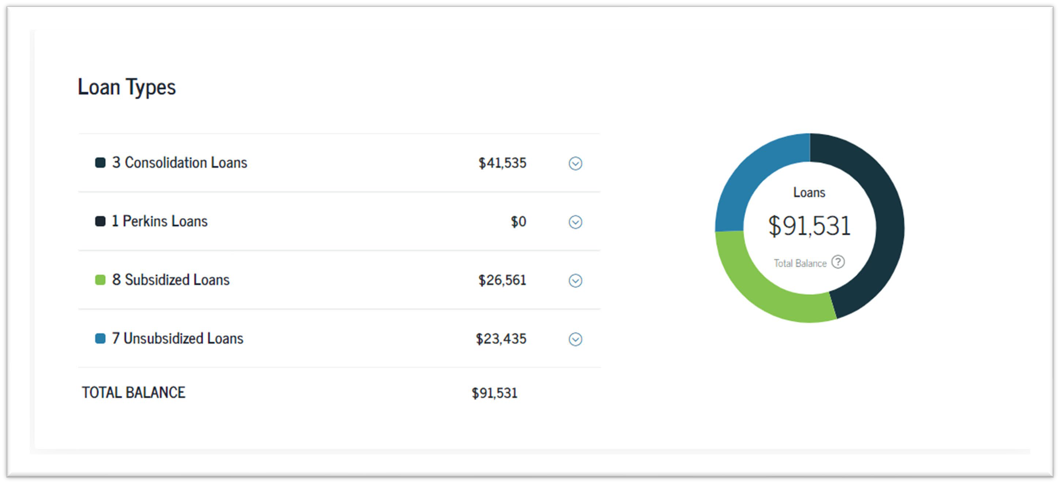

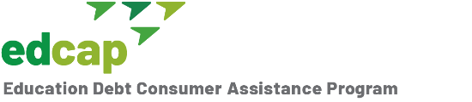
Loan Types Overview
46

Slide 47

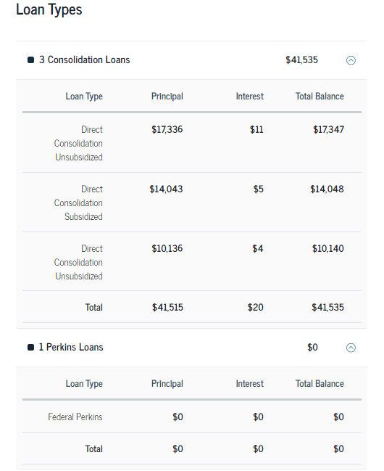

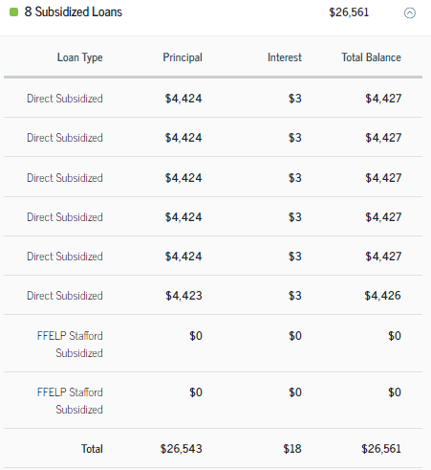
Tip & Reminder: Only “Direct” loans qualify for the Public Service Loan Forgiveness Program. Borrowers who have Perkins or FFELP loans, must consolidate them to make them Direct Loans. But get advice before helping do a consolidation.
Loan Types
37

Slide 48
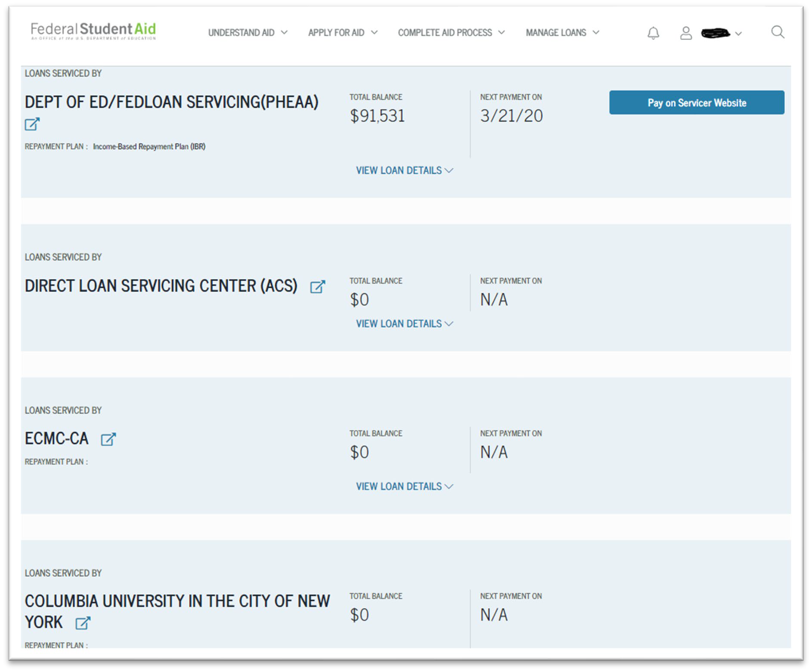
Student Loan Servicer Information
Tip: If you have more than one servicer for your federal student loans, you have the option of consolidating your loans to have only one.
Note: You cannot “consolidate” your private and federal student loans.
Caution: Do NOT get a private loan to pay off your federal student loans without getting unbiased advice. Federal student loans have repayment and forgiveness options that private loans do not have.
48

Slide 49
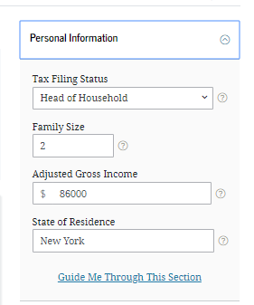
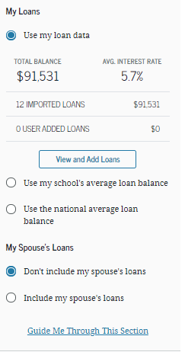
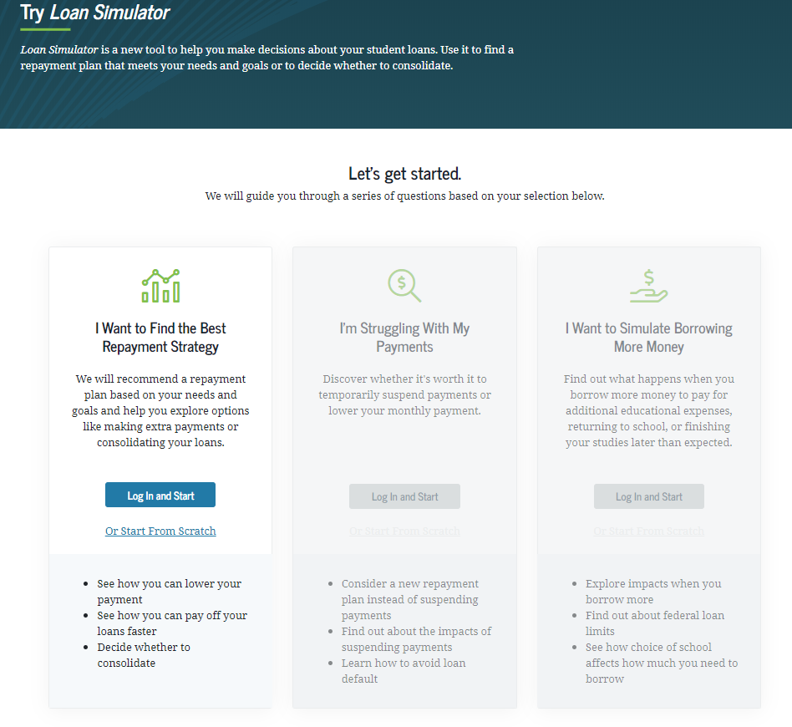
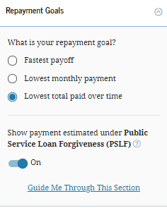
Can I get a sense of my repayment options?
Visit studentaid.gov/loan-simulator.
Allows the borrower to see their repayment options.

Slide 50
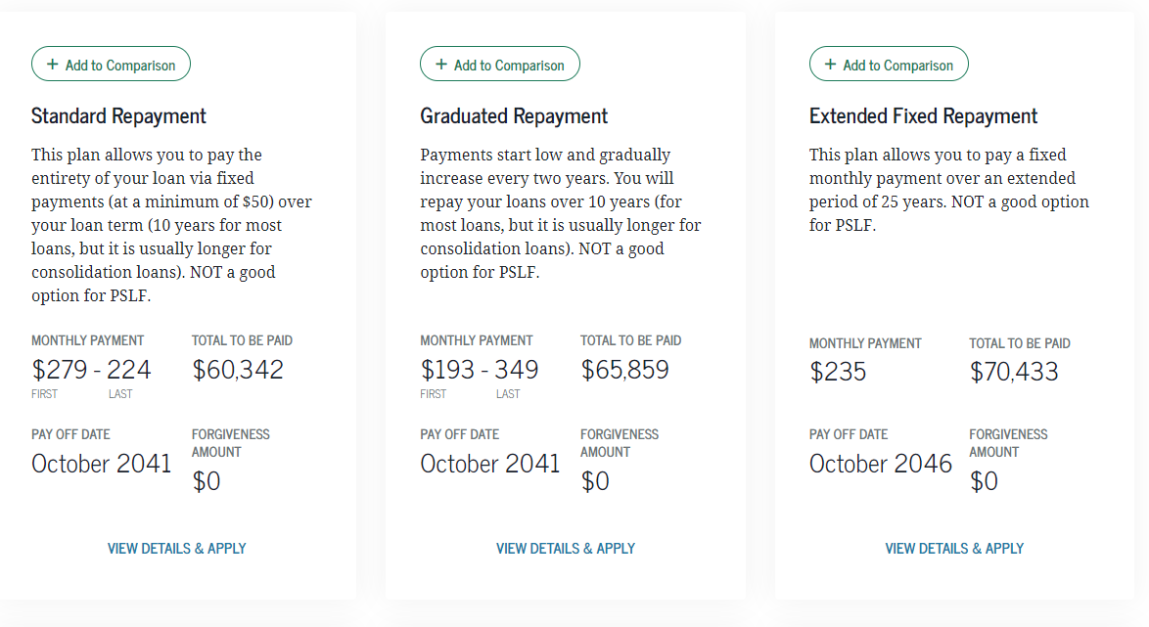
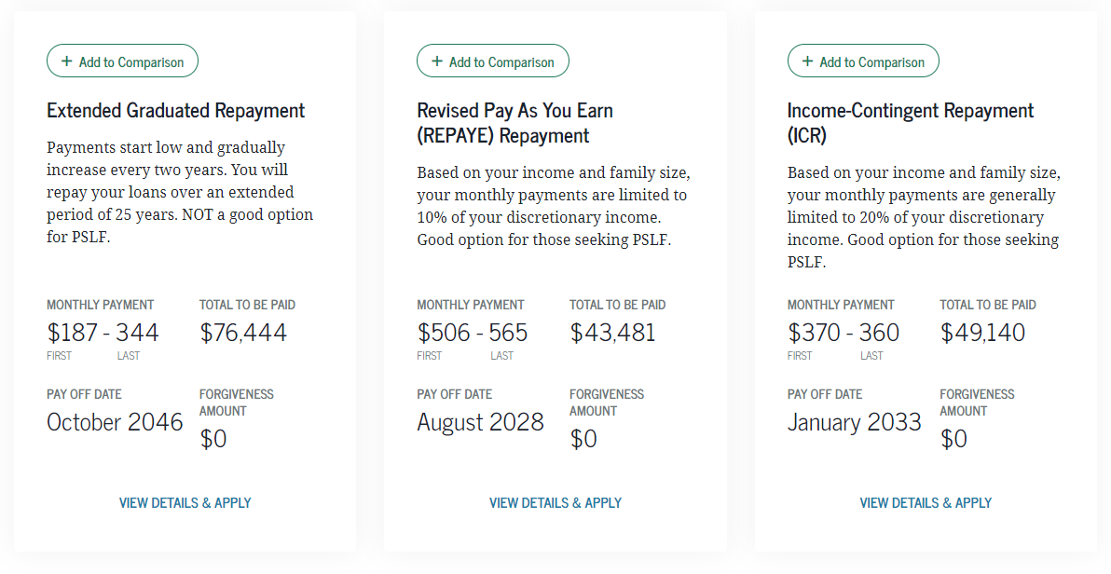
Sample: $35k @ 6.5% interest with 80k in income.

Slide 51
I have a Parent Plus loan but can’t afford the payments
Parent Plus loans are not eligible for Income-Driven-Repayment (IDR) plans.
But they can be consolidated into a “Direct Consolidation Loan” (even if it is only one loan). However, the only IDR plan available to a “Direct Consolidated Loan” that includes Parent Plus Loans is the Income-Contingent-Repayment (ICR) Plan.
In general, don’t consolidate Parent Plus loans with other loan types. Borrowers will limit repayment options to the ICR plan which is often less generous than other plans.

Slide 52
My loan is in default
There are two options for curing a default:
  Rehabilitation: Borrower must call the debt collector to start this process.
  Consolidation: Borrower must file the Consolidation Application Online on the FSA website or manually using this PDF. It’s a two-step process; 1) Apply for Consolidation, 2) Select a Repayment Plan (IDR).
Tip: If you help a borrower consolidate without the help of the debt collector, they may be able to save on collection fees. This can be a few thousand dollars saved!

Slide 53
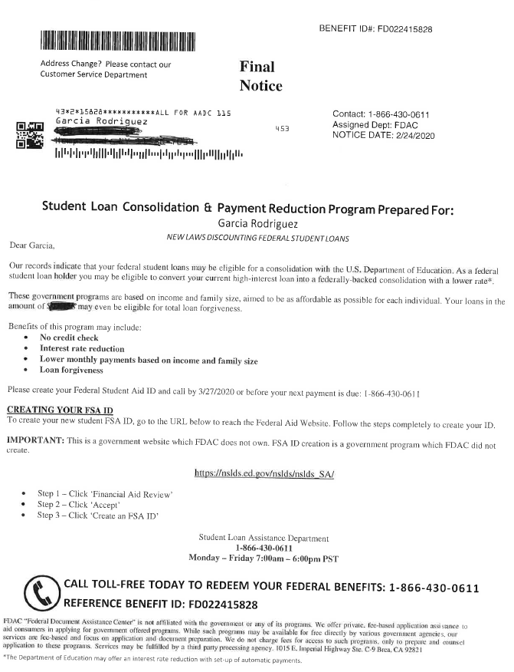
I got a call (email/mail) about reducing my student loan debt…
Caution: There are emerging scams.
Borrowers should not give someone their FSA ID.
No one should have to pay for student loan help.

Slide 54
Why is my loan balance increasing?
Interest Accrual – Interest charges are based on the loan principal balance. For most periods, borrowers will be responsible for paying this amount. “Unpaid Interest” is listed separately from Principal.
Interest Capitalization – Unpaid interest charges are added to the principal balance. Future interest charges are now based on a higher balance. (Compounding!)
Excessive capitalization during the life of a loan can add thousands of dollars to the total amount you pay.
Capitalization may not be avoided completely, but it can be minimized!

Slide 55
Interest Capitalization Triggers
Student loan interest will capitalize:
  When a grace period ends on an unsubsidized loan.
  After a period of forbearance.
  After a period of deferment for unsubsidized loans.
  If you leave the Revised Pay as You Earn (REPAYE), Pay as You Earn (PAYE) or Income-Based-Repayment (IBR) plan.
  If you don’t recertify your income annually for REPAYE, PAYE and IBR plans.
  If you no longer qualify to make payments based on your income under PAYE or IBR.
  If you’re in the Income-Contingent Repayment (ICR) plan, it capitalizes annually.
  When you consolidate federal loans (including consolidating to cure default)

Slide 56
Questions?

