Slide 1
EDCAP Counselor Training 2021 Module 10: Case Handling 101
EDCAP Volunteer Program Training​
Date of Presentation: Wednesday, Nov 17, 2021
Presenters: Courtney Davis and Nancy Nierman

Slide 2
Agenda
Recap: What Counselors Do
Record Keeping
Client Intake Form
Salesforce Checklist
Salesforce
Shadowing
Assignment of Cases
Quality Control and Case Review
Q&A

Slide 3
Recap: What Counselors Do

Slide 4
What Counselors Do: Services Provided
Financial Coaching:
Budgeting and Goal Setting
Credit and Debt Coaching
Information/Education:
Looking up information
Exploring repayment options
Exploring Forgiveness and Discharge
Advocacy:
Conf. calls and support with servicers, lenders, collectors, Dept. of Ed, others.
Applications:
Repayment Plans & IDR Recertifications
Loan Forgiveness and Discharge
Consolidation
Rehabilitation
Deferment and Forbearance, etc.
Referrals
Legal, Other CSS Programs, External Programs, Govt Services
Submitting a Complaint
DOE, DFS, CFPB, etc.

Slide 5
What Counselors Do: Looking Up Records
Begin a case by looking up student loan records (type of loans, loan balance, interest) on the FSA Home Page with an FSA ID.
Most borrowers don’t know if they have federal or private student loans.
They will confuse their servicer with their lender.
They may have multiple servicers.
How to prepare:
Send FSA Establish/Reset Checklist for federal loans.
Remember in some cases, account reset can take multiple days to complete or verify.
Ask client to gather other available documentation for private loans and institutional debt.
If needed, pull their credit report.

Slide 6
What Counselors Do: Explore Repayment
Using the Student Loan Simulator
Located on the FSA website at at https://studentaid.gov/loan-simulator/
Review multiple repayment options and help borrowers narrow them down their options based on their objectives and circumstances.
Loan information can be entered manually or automatically imported from the borrower’s FSA records.
How to prepare:
Send FSA Establish/Reset Checklist.
Request their Adjusted Gross Income (1040, W2, Paystub)
Discuss goals: Pay off loan quickly vs. Low monthly payment
Create a budget, if needed.

Slide 7
What Counselors Do: Explore Loan Forgiveness
Check eligibility for loan forgiveness and discharge programs:
Public Service Loan Forgiveness (PSLF & TEPSLF) and the PSLF Temporary Waiver
https://studentaid.gov/pslf/
Total and Permanent Disability Discharge (TPDD)
www.disabilitydischarge.com
Borrower Defense to Repayment
https://studentaid.gov/borrower-defense/
How to prepare:
Review requirements of the forgiveness or discharge program.
Consult with EDCAP Staff / Request a Case Review

Slide 8
What Coaches Do: Advanced
Direct Loan Consolidation Application:
Free application available on the FSA website at https://studentaid.gov/app/launchConsolidation.action
How to Prepare:
Consult with EDCAP Staff / Request a Case Review
Send Consolidation Checklist
Student Loan Rehabilitation:
Application takes place over a conference call with the borrower’s assigned federal debt collection agency.
How to Prepare:
Consult with EDCAP Staff / Request a Case Review
Create a budget

Slide 9
Record Keeping

Slide 10
Record Keeping: Client Intake Form
Collect EDCAP Client Intake Form information from each client you counsel.
Information on the Intake form:
Client’s contact information
Referral and intake method
Client’s presenting issue or question
Client demographics
How to collect:
Email fillable form to client to be returned prior to session.
Gather information during the session in conversation.

Slide 11
Record Keeping: Salesforce Checklist & Notes
Salesforce Check List
Use this check list as a reminder to ask for certain information that is not captured on the Intake Form and that may not always come up during a session.
Dated Notes:
In addition to information listed on Salesforce Checklist, please keep dated notes describing the content of your conversations and interactions with clients.
Notes can be paper or electronic.

Slide 12
Salesforce Basics: Instructions
Sign into EDCAP Lightning App in Salesforce https://cssnyorg.lightning.force.com/lightning
Click on Contact down arrow → Add Contact
Select FCC & EDCAP Contact
Follow the Intake Form and Salesforce Checklist instructions to enter Contact Details.
Save to generate a new EDCAP Case, then click the case number to enter the EDCAP Case record.
Fill out the following sections:
EDCAP Loans
EDCAP Case Service Details
Log EDCAP Notes

Slide 13
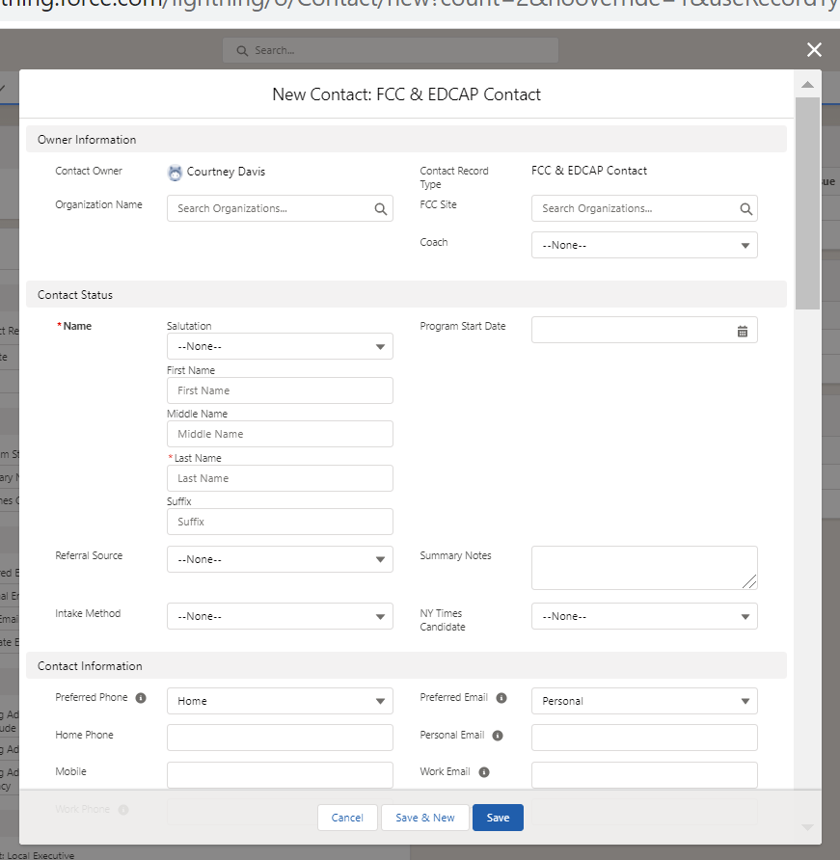
New Contact
Follow the Intake Form and Salesforce Checklist instructions to enter Contact details.
Click the blue Save button to generate a new EDCAP Case, then click the case number to enter the EDCAP Case record.

Slide 14
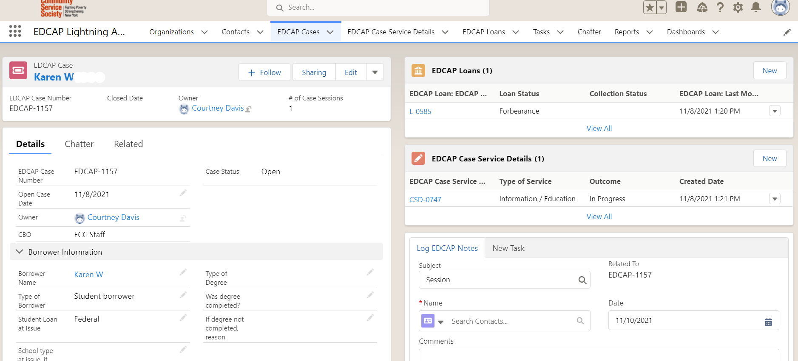
EDCAP Case Details
Fill out EDCAP Loans, EDCAP Case Service Details, and Log EDCAP Notes

Slide 15
Salesforce Accounts and Training
Each EDCAP Counselor will be assigned a unique Salesforce account.
You will be required to maintain your own username and password.
Contacts and their associated case information should be entered into the Salesforce database within a short period, no greater than a month from the date of service.
Salesforce tutorials and instructions will be provided by Courtney during the onboarding process.
Contact Courtney with technical questions about Salesforce and record keeping.

Slide 16
Shadowing

Slide 17
Volunteer Counselor Onboarding
All new EDCAP Counselors will be required to complete two phases of shadowing prior to beginning independent client work.
Courtney will coordinate shadowing schedules.
Counselors will also have the option to participate in mock sessions upon request.
Shadowing Phase 1:
True shadowing. Volunteer joins session with EDCAP staff to observe, with debrief after.
Counselors must shadow 3-4 sessions, with at least two staff before moving into phase 2.
Shadowing Phase 2:
Training sessions. Volunteer will counsel a client with a staff member as back up.
Counselors must complete 2-3 training sessions before counseling alone.
After shadowing Courtney is always available for assistance and feedback to new counselors.

Slide 18
Counselor Schedule
Scheduling:
Upon completion of shadowing, Courtney will work with each volunteer to coordinate scheduling.
Counselors commit to 4-6 hours per week. Volunteer schedules may be flexible or fixed during the week.
Volunteer hours should be tracked and submitted to Courtney monthly.
Vacations, holidays and time off are encouraged for all RSVP volunteers. Let Courtney know your plans.
If you need to cancel an appointment due to illness, etc., please let Courtney know as soon as possible.

Slide 19
Assignment of Client Cases
Assignments:
Nancy Nierman will administer the client distribution list, assigning new clients to each available volunteer.
Courtney will screen the cases and prep counselor for their new clients via email.
Volunteers should monitor inbox for assignments and respond to assignments within 1 business day.
Schedule new clients within same 2-week period they are assigned to you.
No more than 2 new clients per week to start, with opportunity to do more in future.
Counselors schedule their ongoing clients. Make sure to leave room in your schedule for ongoing clients.

Slide 20
Case Review and Rounds
Case Review Process
Courtney reviews all new counselor case salesforce data and case notes.
Courtney may also request info about a case at any time after the session.
Counselors should submit any case they have questions about for immediate review to Courtney.
Courtney will follow up with counselors with feedback, suggestions.
Bimonthly Rounds
Bimonthly remote meeting for counselors and staff.
Opportunity to bring your cases to the group for discussion. Also, brainstorming, discussing new trends, “sentinels”, insights.
New cases: staff will bring up and assign unique cases during rounds.

Slide 21
Q&A
About this or any topic from training.

Slide 22
Congratulations on Completing the 2021 EDCAP Counselor Training!
Welcome to the Team!

