Slide 1
EDCAP Counselor Training 2021 Module 4: Financial Coaching I
Budgeting for Student Loans
EDCAP Volunteer Program Training​
Date of Presentation: Monday, October 18th, 2021​
Presenters: Courtney Davis and Nancy Nierman

Slide 2
Agenda
Introduction to Financial Coaching
Why We Budget
Budget preparation
Household Budget Methodology
Hypothetical
Zero-Based
Budgeting Tools
Case Studies

Slide 3
History of the Financial Coaching Corps
In 2007, CSS launched the Financial Coaching Corps (FCC) in order to address the need for financial education in impoverished urban areas, where lack of conventional banking services encourages use of sub-prime lenders, check-cashing systems, and other high-risk practices.
As early as 2011, FCC staff raised awareness of the student loan crisis as observed by financial coaches during sessions with clients with burdensome student loans.
These observations confirmed the need for an independent consumer assistance program for student loan borrowers, leading to the creation of EDCAP.

Slide 4
What Financial Coaches Do:
The goal of the Financial Coaching Corps is to educate and empower low-wage individuals and families so they can better manage their own financial health and security.
Financial coaches work one-on-one with clients guiding them in developing positive financial skills, including:
Improving credit by obtaining, reviewing and repairing credit reports.
Using formal banking services and avoiding predatory services.
Reducing debt by developing a debt reduction plan.
Creating and using budgets to manage finances.
Screening for public benefits

Slide 5
Consumer Financial Protection Bureau
The Consumer Financial Protection Bureau is a U.S. government agency created in 2011 to provide a single point of accountability for enforcing federal consumer financial laws and protecting consumers in the financial marketplace.
www.consumerfinance.gov
The Financial Coaching Corps utilizes the Your Money, Your Goals Toolkit to help clients achieve financial goals. The toolkit includes a wide variety of budgeting, credit, and debt worksheets.
Your Money, Your Goals Toolkit

Slide 6
The Financial Coaching Feedback Loop
Active Budgeting
Behavior change from avoidance to engagement with finances.
Improved Cashflow
Fewer incidents of financial delinquency and secondary debt accumulation.
Control of Debt
Financial Wellness
Decrease in financial anxiety and increase in financial confidence.
Better management of student loans.

Slide 7
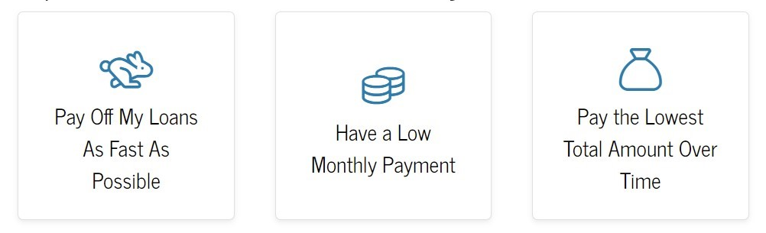
Why We Budget with Borrowers
To understand their household finances and loan burden.
To understand their financial goals, behaviors, and habits.
To understand their risk of delinquency and default.
To maximize the efficiency of their repayment strategy.

Slide 8
Inefficient Student Loan Repayment
Over the past decade, the aggregate annual net repayment rate (or average of existing balances eliminated each year) was just 3%, and many recent graduates have not paid down their balances at all.*
Only 51% of federal borrowers from 2010-12 reduced their loan balances by 2017, despite record economic gains and GDP growth over the same time period.*
A variety of factors can contribute to the problem, including confusion surrounding repayment options, and overuse of deferments and forbearances.
Without a budget-informed strategy, borrowers may find themselves stuck in a cycle of persistent debt.
Moody's Investment Service, 2020

Slide 9
Household Budget Methodology

Slide 10
Household Budget Methodology
While there are a variety of budget methods and methodologies, at it’s most basic a budget is a fact-finding process that answers two important questions:
How much money do you have?
How will you spend it?
Traditional budgeting
A traditional household budget is a guideline for future spending most often presented in monthly format.
Hypothetical budgeting modifies the traditional budget to forecast alternate outcomes.
Using traditional or hypothetical budgeting may leave a budget surplus or deficit.
Zero based budgeting
Zero-based budgeting is a method that encourages you to allocate every penny of your monthly income toward expenses, savings and debt payments. No surplus or deficit, hence the “zero” of zero-based.

Slide 11
Traditional and Hypothetical Budgeting
Traditional household budgeting is the most common method used by individuals and households to manage money.
FCC Budget Worksheet
While the traditional budgeting is easy to explain and to use, other budget methods may work better for financial problem-solving.
Hypothetical budgeting modifies the traditional budget to forecast different scenarios such as:
New job or raise,
Eliminating or reducing specific expenses,
Changes in student loan repayment plan.

Slide 12
Zero-Based Budgeting
Zero-based budgeting is a powerful tool that can help individuals gain control of their financial situation when they haven’t benefitted from a traditional approach. ZBB is especially useful for:
Irregular or fluctuating income,
Out of control spending, borrowing,
Speeding up debt payoff or savings,
Courtney’s Favorite ZBB Tools:
You Need a Budget (YNAB) - App, Software and Free Trainings
Envelope Cash Budgeting
CFPB’s Cash Flow Budget

Slide 13
Tools For Budgeting

Slide 14
Budget Prep Considerations
The budget process must begin at one of three points:
Past months’ bank and credit card statements.
Present month ballpark estimates.
Future month tracking. (CFPB Tracking worksheet).
Will the budget be hands-on or digital? Options include:
pen and paper,
simple or automated spreadsheet,
or a budgeting app.
How much time and maintenance will the budget require?
How often will the budget be reviewed and revised?

Slide 15
Goal Setting
SMART Goals
Specific | What will I achieve? Who will benefit from the goal? What specific thing will I accomplish?
Measurable | How much? How many? How will I know when it's done?
Achievable | Is this goal something that I can actually reach? Do I have the tools and support I need to accomplish this?
Relevant | Is this something that I really want? Is now the right time to do this? Why is this goal important?
Time-bound | When will I reach this goal? Is the time frame reasonable?
Individuals may have financial goals, but budgeting requires clear terms. The SMART goals method is a quick solution.
Goals:
I’d like to buy a new television.
I want to get out of credit card debt.
SMART Goals:
I will save $400 and purchase a new TV in 5 months.
Budget $80 per month for “New TV”.
I will pay down $1,000 of my debt over the next 18 months.
Budget $55.55 per month for “Debt Payoff”.

Slide 16
Expense Categorization
Traditional budgeting expense categories include:
Needs are required for survival and basic comfort. (Rent, utilities, food, medication.)
Wants are not required for survival or duty. (Vacations, impulse shopping, luxuries.)
Note: Certain expenses could be either needs or wants depending on the client. Examples: childcare, a car, clothing, travel, internet, grooming, etc.
Obligations are any financial commitment that one has a duty to pay.
Examples: any kind of debt (credit cards, student loans, court judgments), non-debt obligations (child support, taxes, insurance, dues), or obligation to oneself (emergency savings, 401k).
These categories may also be considered Non-Negotiable (Priority), Negotiable, Discretionary.

Slide 17
Calendar or Timeline
Monthly Bill Calendar
Bill | Due Date
Pay These Bills on the: | 26th | of each month
Mortgage/Rent | 1
Property Taxes | 2
Car Payment | 5
Credit Card-Amex | 7
Credit Card-MasterCard | 7
Cable | 8
Pay These Bills on the: | 10th | of each month
Car Insurance | 14
Utility-Electric | 15
Student Loans | 18
Cell Phone | 20
Pay These Bills on the: | 19th | of each month
Credit Card-Macy's | 23
Health Insurance | 25
Utility-Gas | 28
When budgeting, it's always important to keep track of dates of upcoming income, bills, auto-payments, and annual payments.
Create a timeline or use a calendar to mark off important dates.
This activity can help clients avoid missed payments, credit damage, fees and interest charges.

Slide 18
The EDCAP Automated Budget Spreadsheet
Presented by Nancy Nierman

Slide 19
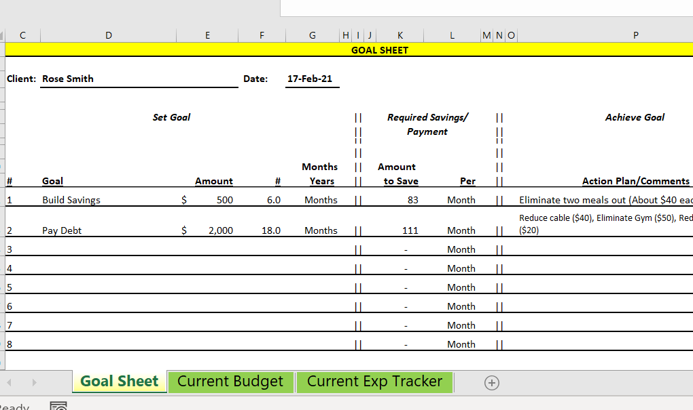
Automated Spreadsheet
This multipart automated spreadsheet was created by Nancy Nierman.
You can access blank copies of the spreadsheet on the agency portal.

Slide 20
Case Study: Leah, Budget/Student Loans
Recent graduate with $25,000 federal student loans .
Has been living with parents with very low expenses.
Has been paying $300/mo on student loans during the covid suspension.
Just landed first job for $48.5k/year. Wants to move out but continue to pay more than required on her student loan.
It has been easy for Leah to make payments of $300 while she’s at home and has almost all her expenses covered by her parents.
Her current budget includes $400/mo. for vacations, $200/mo. for dining out and $200/mo. on gifts and miscellaneous.
The lowest required payment on her loans when the covid suspension ends will be $211/mo. In an IDR plan…

Slide 21
Case Study: Leah (Cont’d)
Recent graduate with $25,000 federal student loans .
Has been living with parents with very low expenses.
Has been paying $300/mo on student loans during the covid suspension.
Just landed first job for $48.5k/year. Wants to move out but continue to pay more than required on her student loan.
After completing a “Hypothetical Budget” using actual income, actual student loan payment and other estimated expenses assuming she’s living on her own, Leah will have a monthly deficit of about $100 if she does not change some her spending habits.
Leah now realizes that she will have to cut back in certain areas to meet her student loan payments and that she may not be able to continue paying at the current rate.

Slide 22
Case Study: Leah, Budget/Student Loans, Conclusion, Before Budget Adjustments
Leah will have to reduce spending in the discretionary area to make her student loan payments and build savings after moving out on her own.

Slide 23
Case Study: Leah, Budget/Student Loans, Conclusion, After Budget Adjustments
Leah cut vacation and dining out expenses in half. She will be able to continue to make student loan payments of $300 AND put some money into savings every month!

Slide 24
Case Study 2: Christopher and Amy, engaged
Christopher has $135,000 loan debt from grad school.
He makes $65,000 per year and pays $391 monthly under REPAYE.
Amy earns $100,000 and is paying $4,000+ per month in home costs.
After they’re married, their combined income will be $165,000. As a result, Chris’ loan payment is set to rise to $1128.
Christopher and Amy are seeking financial coaching and student loan counseling as they prepare for married life. The couple have differing goals when it comes to household finances.
Amy, wants to focus on quickly paying down the couple’s debts (mortgage and student loan) and saving for retirement.
Christopher, who has recently completed grad school, is feeling overwhelmed by his debt and generally less confident planning for the future.

Slide 25
Case Study 2: Chris and Amy, Before Budget Adjustments
INCOME:
Income: Wages & Bonues | 9,368
Priority Expenses: | 5,960
Home-Mortgage/Taxes/Insurance | 4,850
Utilities | 170
Food (Groceries) | 400
Medical Insurance | 290
Public Transportation | 250
Obligations/Necessities: May be reduced or renegotiated | 3,598
Savings/Emergency Fund | 1,500
Student Loans | 1,128
Phone (Cell) | 140
Computer (Internet) | 100
Clothing-self/partner/spouse | 300
Laundry/Dry Cleaning | 100
Toiletries, Household Products | 80
Home Improvements/Repairs | 250
Discretionary: | 880
Cable TV/Videos/Movies | 110
Subscriptions & Dues | 100
Vacations | 200
Food-Eating Out | 150
Fitness | 120
Gifts/Donations | 100
Grooming (Hair, Make-up, Other) | 50
Other Miscellaneous Expenses | 50
Grand Total Monthly Income | 9,368
Grand Total Monthly Expenses | (10,438)
Grand Total Surplus/Deficit | -1394
After the first pass going over the couple’s hypothetical married budget, you find a significant monthly deficit of $1,394.

Slide 26
Case Study: Christopher and Amy, engaged
Christopher has $135,000 loan debt from grad school.
He makes $65,000 per year and pays $391 monthly under REPAYE.
Amy earns $100,000 and is paying $4,000+ per month in home costs.
After they’re married, their combined income will be $165,000. As a result, Chris’ loan payment is set to rise to $1128.
After creating a “hypothetical budget” the couple realizes they will need to adjust their plans and their spending.
First, the couple agrees to greatly reduce their overall expenses. Then they review other options for student loan repayment.
In order to preserve their retirement contributions, Chris will enroll in Income-Based Repayment and the couple will file their taxes separately.
These changes will generate a monthly surplus of $439.

Slide 27
Case Study 2: Chris and Amy, After Budget Adjustments
INCOME:
Income: Wages & Bonues | 9,368
Priority Expenses: | 5,860
Home-Mortgage/Taxes/Insurance | 4,850
Utilities | 170
Food (Groceries) | 300
Medical Insurance | 290
Public Transportation | 250
Obligations/Necessities: May be reduced or renegotiated | 2,569
Savings/Emergency Fund | 1,500
Student Loans | 324
Phone (Cell) | 140
Computer (Internet) | 100
Clothing-self/partner/spouse | 75
Laundry/Dry Cleaning | 100
Toiletries, Household Products | 80
Home Improvements/Repairs | 250
Discretionary: | 500
Cable TV/Videos/Movies | -
Subscriptions & Dues | -
Vacations | 200
Food-Eating Out | 150
Fitness | -
Gifts/Donations | 100
Grooming (Hair, Make-up, Other) | 50
Other Miscellaneous Expenses
Grand Total Monthly Income | 9,368
Grand Total Monthly Expenses | (8,929)
Grand Total Surplus/Deficit | 439
Outcome: By strategically opting for a lower student loan payment, the couple can choose to allocate their surplus of $439 each month as needed.

