Slide 1


EDCAP Ambassador
Training 2021
Module 2: Community Outreach
EDCAP Volunteer Program Training​
Date of Presentation: Wednesday, October 20th, 2021
Presenters: Courtney Davis and Carolina Rodriguez

Slide 2
Agenda
What Ambassadors Do
Networking/ Researching
Lead Types
Ambassador Toolkit
Giving Presentations
Q&A
2

Slide 3
What do EDCAP Ambassadors do?
Network: Ambassadors conduct community outreach activities (including emails, phone calls, and distributing EDCAP branded materials) to generate new leads for EDCAP partnerships within a designated geographic region of New York City.
Pursue Leads: Volunteers also pursue leads generated by EDCAP staff or other volunteers to set up presentations and other events for EDCAP.
Conduct Presentations: Ambassadors conduct remote or in-person presentations to promote EDCAP’s services and to educate the community about student loan topics. Substantive presentations will be done in collaboration with EDCAP staff.
Goal: Conduct 1-2 presentations per month, per volunteer.

Slide 4
Where to begin? Networking.
You may want to begin your role by reaching out to contacts within your personal, professional and community networks.
Creating your own “network map” is a helpful exercise to kick off your outreach efforts.

Slide 5
Where to begin? Researching.
As an EDCAP Ambassador get to know your specific borough or focus area of New York City.
  Who lives, works, and participates in your local community? What do you know about them? What are the borough demographics?
  What events are happening in your community and how do you gather that information? What are other service organizations doing in our community?
  What student loan issues matter most to the people we are trying to engage?

Slide 6
Leads to Track for EDCAP
Presentations and Outreach
  Opportunities to promote EDCAP via presentation to community groups such as social service organizations, local colleges, libraries, workforce development organizations, NY Health and Hospitals.
  Opportunities to distribute flyers and other activities outlined in a Community Outreach Brief.
Events and Media
  Local opportunities to table an event or provide panelist at community board meetings, conventions, resource fairs, job fairs, etc.
  Local news media opportunities: print, radio, tv, social media.
Referrals and Partners
  Local leaders, representatives and community liaisons, and any local organization that would like to establish a partnership to refer clients or otherwise support our mission.

Slide 7
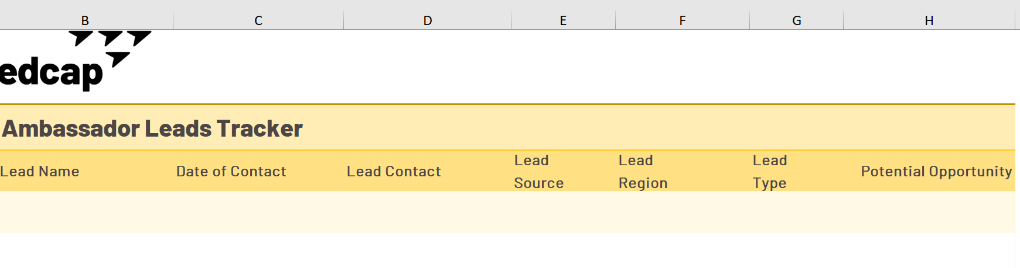
Keeping Track of Leads:
Lead Tracker. Found in the Ambassador Toolkit. Use the Lead tracker to record ANY contacts and activities you find.
Ambassador Monthly Outreach Log. This document helps us capture information about your networking activities and your observations in your community. Submit a copy monthly to Courtney.

Slide 8
Ambassador Toolkit

Slide 9
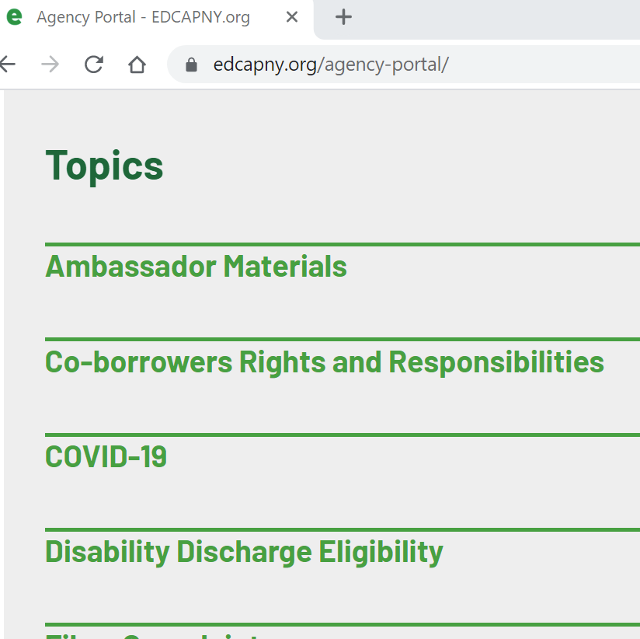
EDCAP Agency Portal
All Ambassador materials will live on our shared Agency Portal.
To access the volunteer portal, go to https://www.edcapny.org/agency-portal/
Enter password: volunteer2019

Slide 10
Ambassador Toolkit
Target population:
Prospective and Current Students
Public Servants
Parent Borrowers and Co-signers
Borrowers with Disabilities
Older Adult Borrowers
All Borrowers (General Category) AKA “In Repayment”
Borrowers in Default
Outreach Toolkits by population:
Toolkits include the following materials to assist your outreach efforts:
  Factsheets/Resources for target population
  Talking points/Outreach plan
  Accompanying PowerPoint (if relevant, like PSLF).

Slide 11
Conducting EDCAP Presentations

Slide 12
Conducting EDCAP Presentations
Step 1: Access Ambassador Toolkit on the Agency Portal and download a Workshop Request Form, and other materials.
Step 2: Send Workshop Request Form to gather the details from your lead. You could also help complete it.
Step 3: Keep track of your plans via the trackers in the Toolkit.
Step 4: Report the workshop request and coordinate presentation logistics with Courtney.
  Courtney will work with you to make sure you have the materials you need. For substantive presentations, EDCAP staff will co-host the presentation.

Slide 13
Conducting EDCAP Presentations (cont.)
Step 4: Present the material. Leave some time for Q&A.
Step 5: Do any necessary follow up, which can include sending a copy of the presentation and recording of the presentation.
Step 6: Record details and provide to Courtney in the Monthly Outreach Summary Report.

Slide 14
Presentation Deck Options
The Ambassador Deck is a basic / generalized PowerPoint covering:
  Overview of EDCAP’s mission and goals.
  How we help a variety of client groups with various student loan issues.
  If you are interested in or receive a request for something more specific, let Courtney know. Courtney will work with you to modify the presentation to your needs and to make sure you are well-versed in the topic.
  Examples include:
    Most Common Mistakes Borrowers Make
    Financing Higher Education
    Managing Student Loans Amid COVID-19
    Student Loans: What to Do before Payments Resume
    Public Service Loan Forgiveness: Stay on Track to Qualify

Slide 15
Q&A
Thanks! Let me know if you have any questions.

