Slide 1
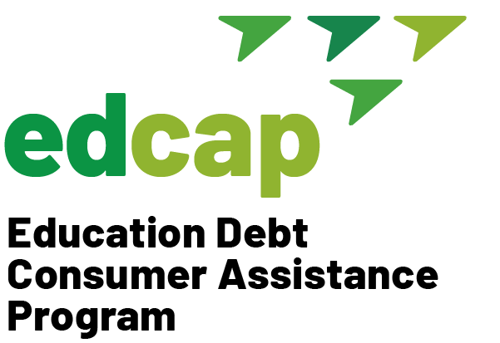
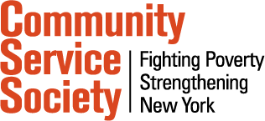
EDCAP Ambassador Training 2021 Module 1: Introduction to EDCAP
EDCAP Volunteer Program Training
Date of Presentation: Monday, October 18th, 2021
Presenters: Courtney Davis and Nancy Nierman

Slide 2
Agenda
Student Loan Crisis
All About EDCAP
Student Loan Basics
Common Mistakes

Slide 3
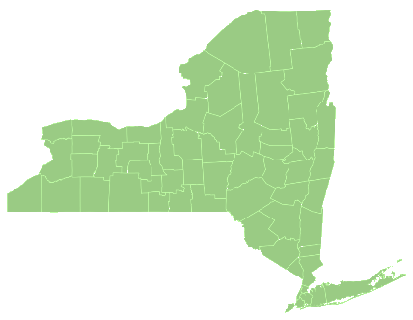
Student Loan Crisis in New York
In New York State
2.4+ million borrowers
98+ billion owed
$38,000 average debt
220,000 older adults carry student debt
11.6% delinquency rate
In New York City
1 million borrowers
Bronx has highest default rate (19%), followed by Brooklyn (15%), Manhattan (12%), Queens (12%), Staten Island (11%)

Slide 4
The Student Debt Crisis Nationally
Over the last two decades, student loan borrowing increased dramatically
Currently:
$1.7 trillion owed
45 million borrowers
Source: FRBNY Consumer Credit Panel/Equifax; Graph by the Century Foundation

Slide 5
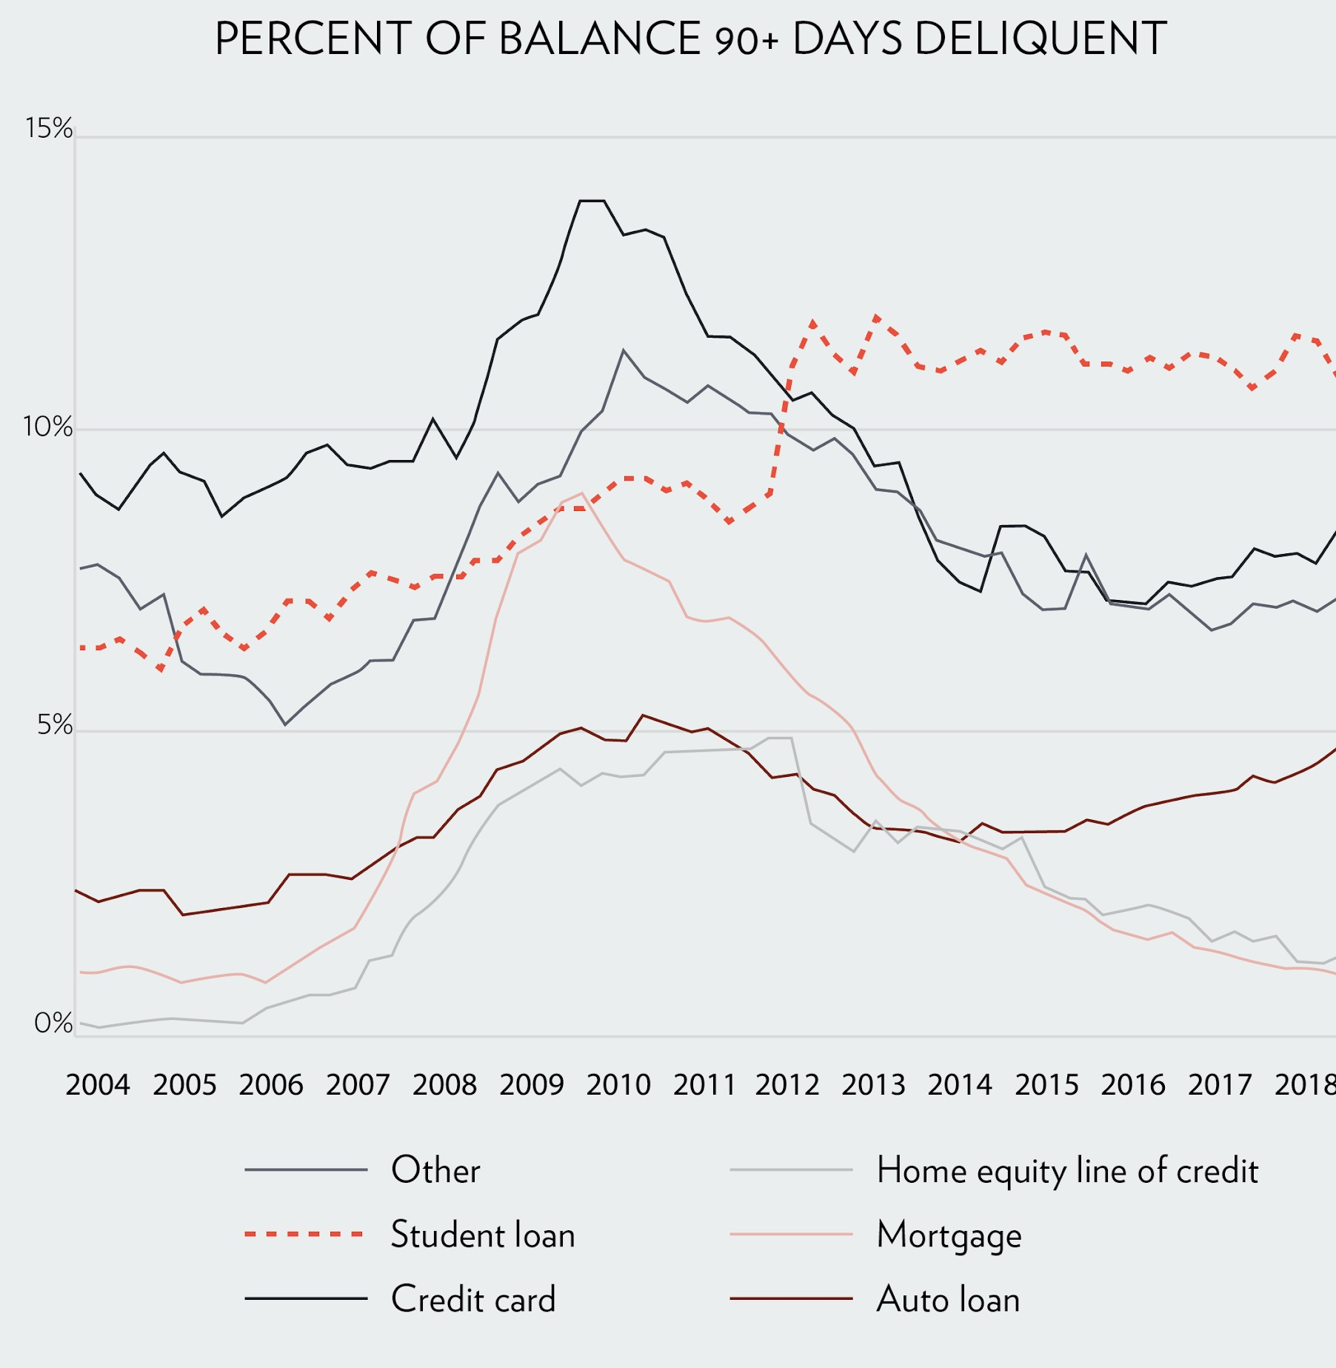
The Student Debt Crisis Nationally (cont'd)
11% delinquency and default rate.
Repayment has been slow with high delinquency and default.
More people are delinquent on their student loans than any other type of debt.
Source: FRBNY Consumer Credit Panel/Equifax; Graph by the Century Foundation

Slide 6
Student Loan Crisis: The Impact
Defaulting means lower credit score, which leads to higher insurance premiums, less access to affordable housing, and increase cost of borrowing for other needs.
Large debt leads to the inability to purchase a home, save for retirement, accumulate wealth or save for your children’s education.
Women, African Americans, and Latinos are more adversely impacted by student debt.

Slide 7
The Education Debt Consumer Assistance Program (EDCAP)

Slide 8
Who We Are
Created in 2019 to help student loan borrowers across New York State effectively manage their debt and improve their financial health by providing free, unbiased, one-on-one consumer assistance.
EDCAP is a one-stop shop for student loan debt and related issues, assisting both federal and private borrowers.
8

Slide 9
What We Do
Everything we can to help borrowers manage and when possible, eliminate their student debt! We help borrowers…
Determine their best repayment options;
Access loan forgiveness, cancellation, and discharge programs;
Get out of default to prevent wage garnishments, social security offsets, and tax intercepts;
Resolve issues with loan servicers and lenders;
Obtain referrals to other services and resources to address additional needs.
9

Slide 10
EDCAP’s “Hub-and-Spokes” Model
Hub: Community Service Society administers the program and runs the helpline with highly trained volunteers and staff
Spokes: Community- based organization that provide in-person services across NYS
Helpline
Complex cases
CBO learning community
CBO procurement and administration
QA & monitoring
Reporting to funders
Sentinel function
Outreach
Community presentations
Casework
Sentinel function
Technical Assistance
Training
Casework
Specialists: Provide technical assistance and training to spokes

Slide 11
What We’ve Done (2019-2020)
1,556 borrowers reached through education and presentations
1,033 one-on-one counseling sessions
$1,462,539 in consumer savings
$22,808,569 in student loan debt managed
11

Slide 12
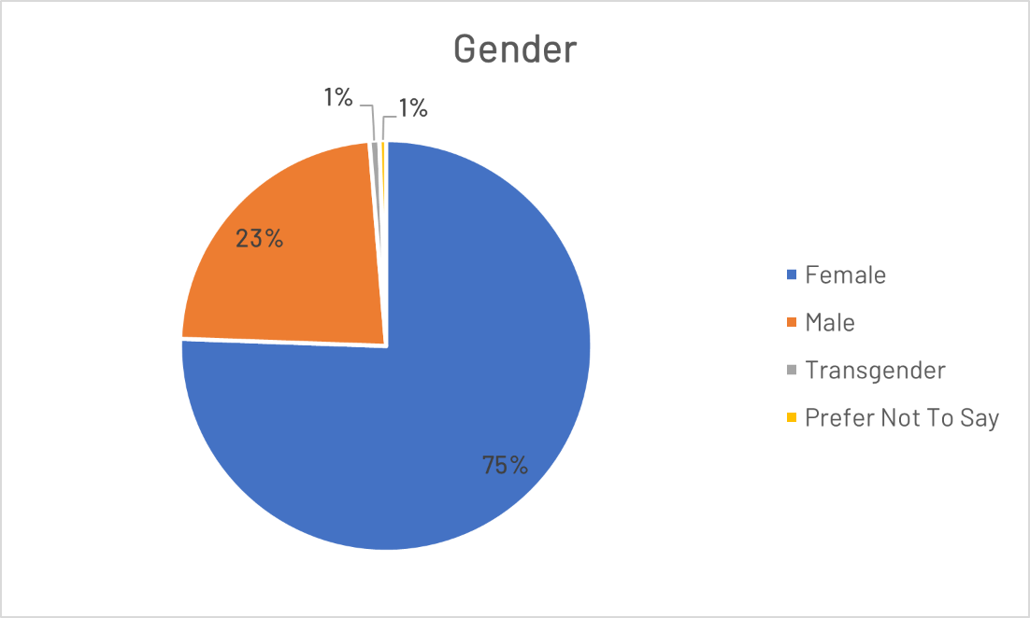
Who We Serve
Did you know? Nationally, women owe two-thirds of all outstanding student loan debt, yet they only make up half of all college students.

Slide 13
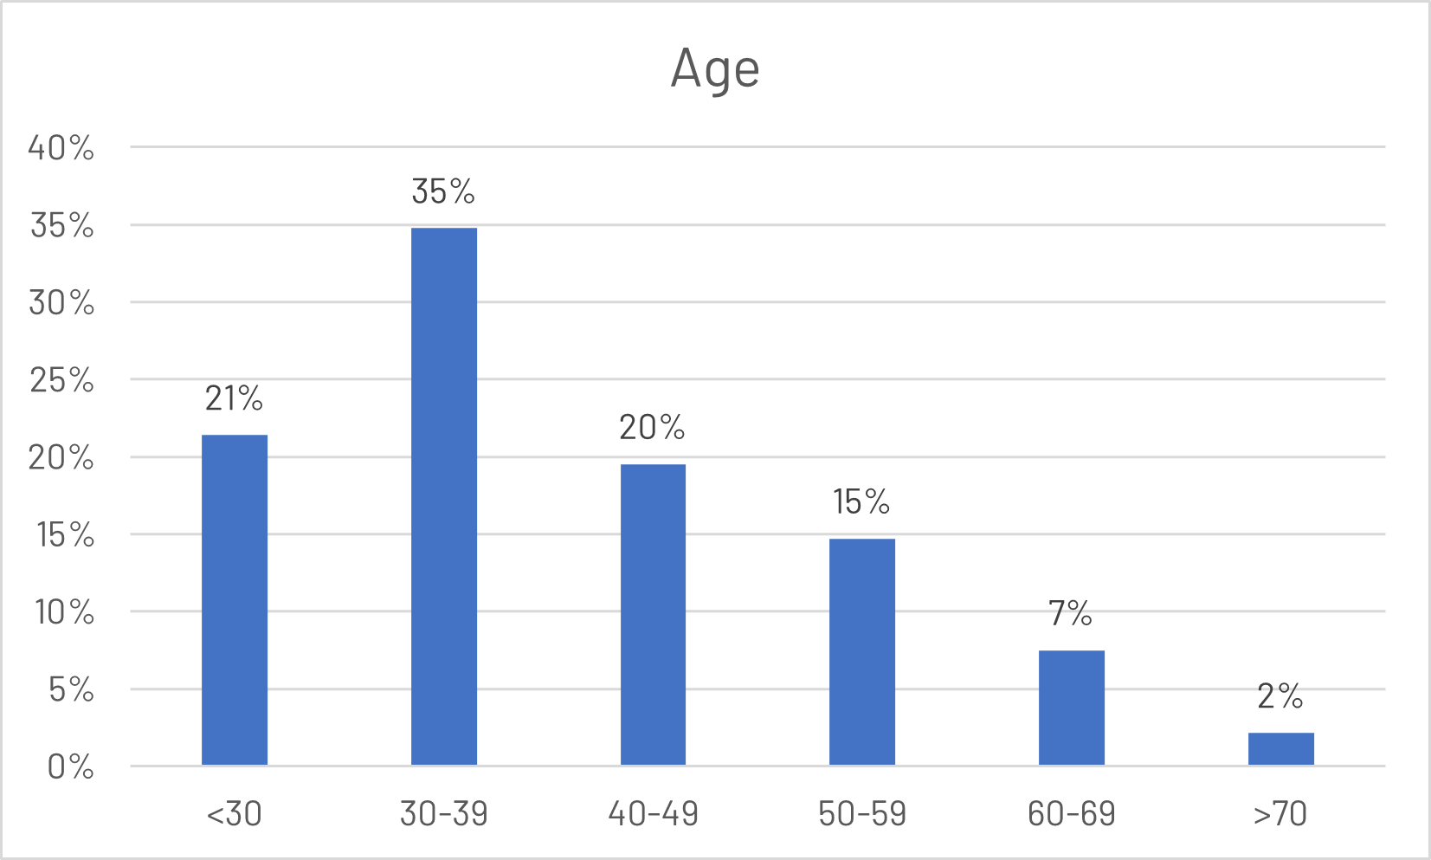
Who We Serve
Did you know? In the U.S., about 20% of the total student loan debt is owed by borrowers 50 and older!

Slide 14
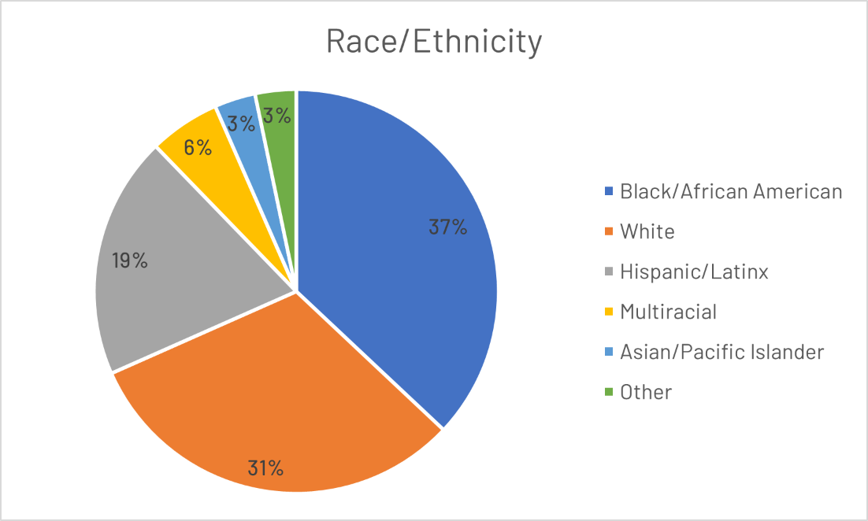
Who We Serve
Did you know? Black borrowers are twice as likely to default on their student loans and see their balances increase over time compared to their peers.

Slide 15
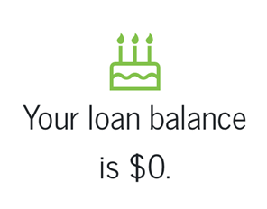
“I want to be done with this debt. I have been dealing with this for 50 years.”
EDCAP helped Kate T. settle her debt.

Slide 16
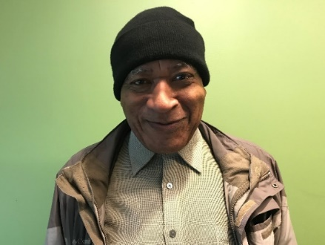
“I want to move forward and find a permanent home. I can't believe the government is doing this to me and people like me.”
EDCAP helped Donald G. get his student loans out of default and stop his social security offset.

Slide 17
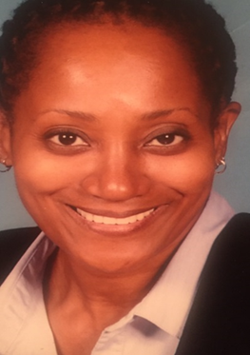
“My EDCAP counselor was patient, cut through the confusion and in the end, we were victorious! I wish I had heard about them sooner.”
EDCAP helped Joean T. consolidate her loans, get her in an affordable repayment plan, and she is now working towards Public Service Loan Forgiveness.

Slide 18
Federal Student Loans: The Basics

Slide 19
Federal Direct Subsidized and Unsubsidized Loans
Subsidized loans are for undergraduates only.
Unsubsidized are for both undergraduates and graduate student.
There are annual and aggregate loan limits.
If you reach the limit, you can take out more if you first pay down your outstanding loan debt.
Dependent undergraduate students
First year | $5,500 overall; $3,500 subsidized
Second year | $6,500 overall; $4,500 subsidized
Third year and up | $7,500 overall; $5,500 subsidized
Total limit | $31,000 overall; $23,000 subsidized
Independent undergraduate students
First year | $9,500 overall; $3,500 subsidized
Second year | $10,500 overall; $4,500 subsidized
Third year and up | $12,500 overall; $5,500 subsidized
Total limit | $57,500 overall; $23,000 subsidized
Graduate and professional students (unsubsidized only)
Annual limit | $20,500
Total limit | $138,500, including undergraduate loans
Source: 34 CFR § 685.203.
19

Slide 20
Federal Direct Plus Loans for Graduates, Professionals and Parents
There are no specific caps on PLUS loan borrowing and credit is considered.
Maximum amount is the school’s cost of attendance minus other financial aid you receive, or your child receives.
Cost of attendance includes tuition and fees, room and board, and books and other supplies.
Tip: Max out federal subsidized and unsubsidized direct loan borrowing before tapping PLUS loans. PLUS loans will have higher interest rate. Current rate is 5.30%.
Caution: Because the limits are high, it is easy to borrow large amounts of Plus Loans. Know what your monthly payments will be and borrow with caution.
Source: 34 CFR § 685.203.
20

Slide 21
Private Loans
Limits vary by lender. Typically, it can’t exceed the cost of attendance.
Credit will be considered, which means it will likely require a co- signer.
Interest rates will be higher.
Caution: Stop before you sign. Consider your current and total education debt. Know what your payments will be upon graduation. If you co- sign, you are 100% liable for the private loan.
Tip: Max out federal student loan borrowing before taking out private student loans. Federal loans have protections that private loans don’t, including income-driven repayment plans and loan forgiveness programs.
21

Slide 22
Student Loan Repayment Process
Deferment or Forbearance
Paid As Agreed
Paid in Full or Forgiven
Loan Issued
(In-School Deferment/Grace Period)
In Repayment
Delinquency (90 days late)
Default (270 days late)
Collections and
Garnishment
22

Slide 23
Understanding student loans
Loan Programs:
Loan Status:
Repayment Plans:
Loan Servicer:
Determine where your funds come from (directly from the government, through a bank or through the school), the interest rate and what kinds of repayment plans and forgiveness programs you may be eligible for.
Describes what phase of the process you are in and what is expected of you in terms of payment.
Dictate how much your monthly payment will be, how long it may take to pay off your loan and how much you might pay in total.
Administers your loans; sends invoices, collects payments, processes applications, etc. They are your point of contact when your loan is in good standing (Note: Defaulted loans are handled by US government approved debt collectors).
Examples: Direct, FFEL, Perkins, etc.
Examples: Deferment, Forbearance, Grace Period, In-Repayment, Default.
Examples: Standard Fixed, Standard Graduated, Income Driven Repayment (IDR), etc.
Examples: Navient, Fedloan Servicing, MOHELA, etc.

Slide 24
Loan Programs
Loan Status
Repayment Plans
Loan Servicer
The William D. Ford Federal Direct Loan Program-Loans come directly from the Federal Government.
Direct Subsidized Loans-The government covers unpaid interest during certain periods.
Direct Unsubsidized Loans-The borrower is generally responsible for interest accrued.
Direct Plus Loans for Graduates and Professionals-only unsubsidized loans available.
Credit check required.
Direct Plus Loans for Parents-Offered to parents of college students. Only unsubsidized loans available. Credit check required.
Direct Consolidation Loans-Allow borrower to combine loans for ease of administration.
Does not lower interest rates.
Federal Family Education Loan (FFEL)-Loans came from banks, guaranteed by the Federal Government. This loan program is no longer available.
Federal Perkins Loans-Federal Government subsidized loans offered to students with great financial need directly through the school. This loan program is no longer available.
FEDERAL STUDENT LOANS ARE ONLY OFFERED THROUGH THE DIRECT LOAN PROGRAM TO NEW BORROWERS.
24

Slide 25
Loan Programs
Loan Status
Repayment Plans
Loan Servicer
Subsidized
For undergraduate students only.
Borrower must have financial need.
Interest paid by the government while in school or deferment, and during certain payment plans.
Unsubsidized
For all borrowers.
Borrower not required to show financial need.
Interest is paid by the borrower in most cases.
For graduate students (Grad PLUS) and parents of students (Parent PLUS).
PLUS
Borrower must have a positive credit history.
Interest is always paid by the borrower.
Consolidation
For all borrowers.
Borrower must graduate or drop below half-time status at school.
Mixture of subsidized and unsubsidized interest.

Slide 26
Loan Programs Loan Status Repayment Plans Loan Servicer
In School Deferment – While you are in school at least half time. No payment is required.
Grace Period-The six months following graduation, leaving school or dropping below half-time status. No payment is required.
Deferment or Forbearance- Provides temporary relief from payment (up to one year at a time). Generally, no payment is required.
Repayment- You are enrolled in a repayment plan and a payment may be required.
Default- You have been delinquent or have failed to make payments for at least 270 days and your loans are now payable in full.
26

Slide 27
Loan Programs
Loan Status
Repayment Plans
Loan Servicer
The Standard Plans: Payments are based on size of loan, interest rate and pre-determined payback period.
Income-Driven-Repayment (IDR) Plans: Payments and payback period are based on your income.
Standard (10 -30 years)*
Revised Pay As You Earn (REPAYE)
Graduated (10 -30 years)*
Pay As You Earn (PAYE)
Income Based
Repayment (IBR)
For borrowers before July 1,2014
For “New Borrowers” after July 1,2014
Extended Fixed (Up to 25 years)
Extended Graduated (Up to 25 years)
Income Contingent Repayment (ICR)
Sources: 4 CFR § 682.209.
* Consolidated loans can qualify
for standard plans up to 30 years.
27

Slide 28
Loan Programs
Loan Status
Repayment Plans
Loan Servicer
Federal Student Loan Servicers | Phone Number | Note
ECSI | 1-866-313-3797
FedLoan Servicing (PHEAA) | 1-800-699-2908 | Exiting servicing business
Granite State-GSMR | 1-888-556-0022 | Exiting servicing business
Great Lakes Educational Service | 1-800-236-4300
HESC/Edfinancial | 1-855-337-6884
MOHELA | 1-888-866-4352
Navient | 1-800-722-1300 | Exiting servicing business
Nelnet | 1-888-486-4722
OSLA Servicing | 1-866-264-9762
28

Slide 29
The National Student Loan Database

Slide 30
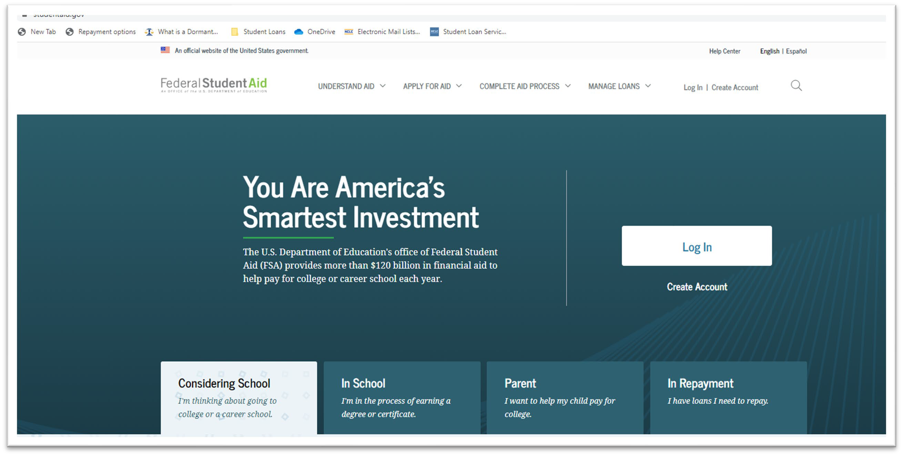
Federal Student Aid Account Information
Visit studentaid.gov and have client Log In with their FSA ID.
30

Slide 31
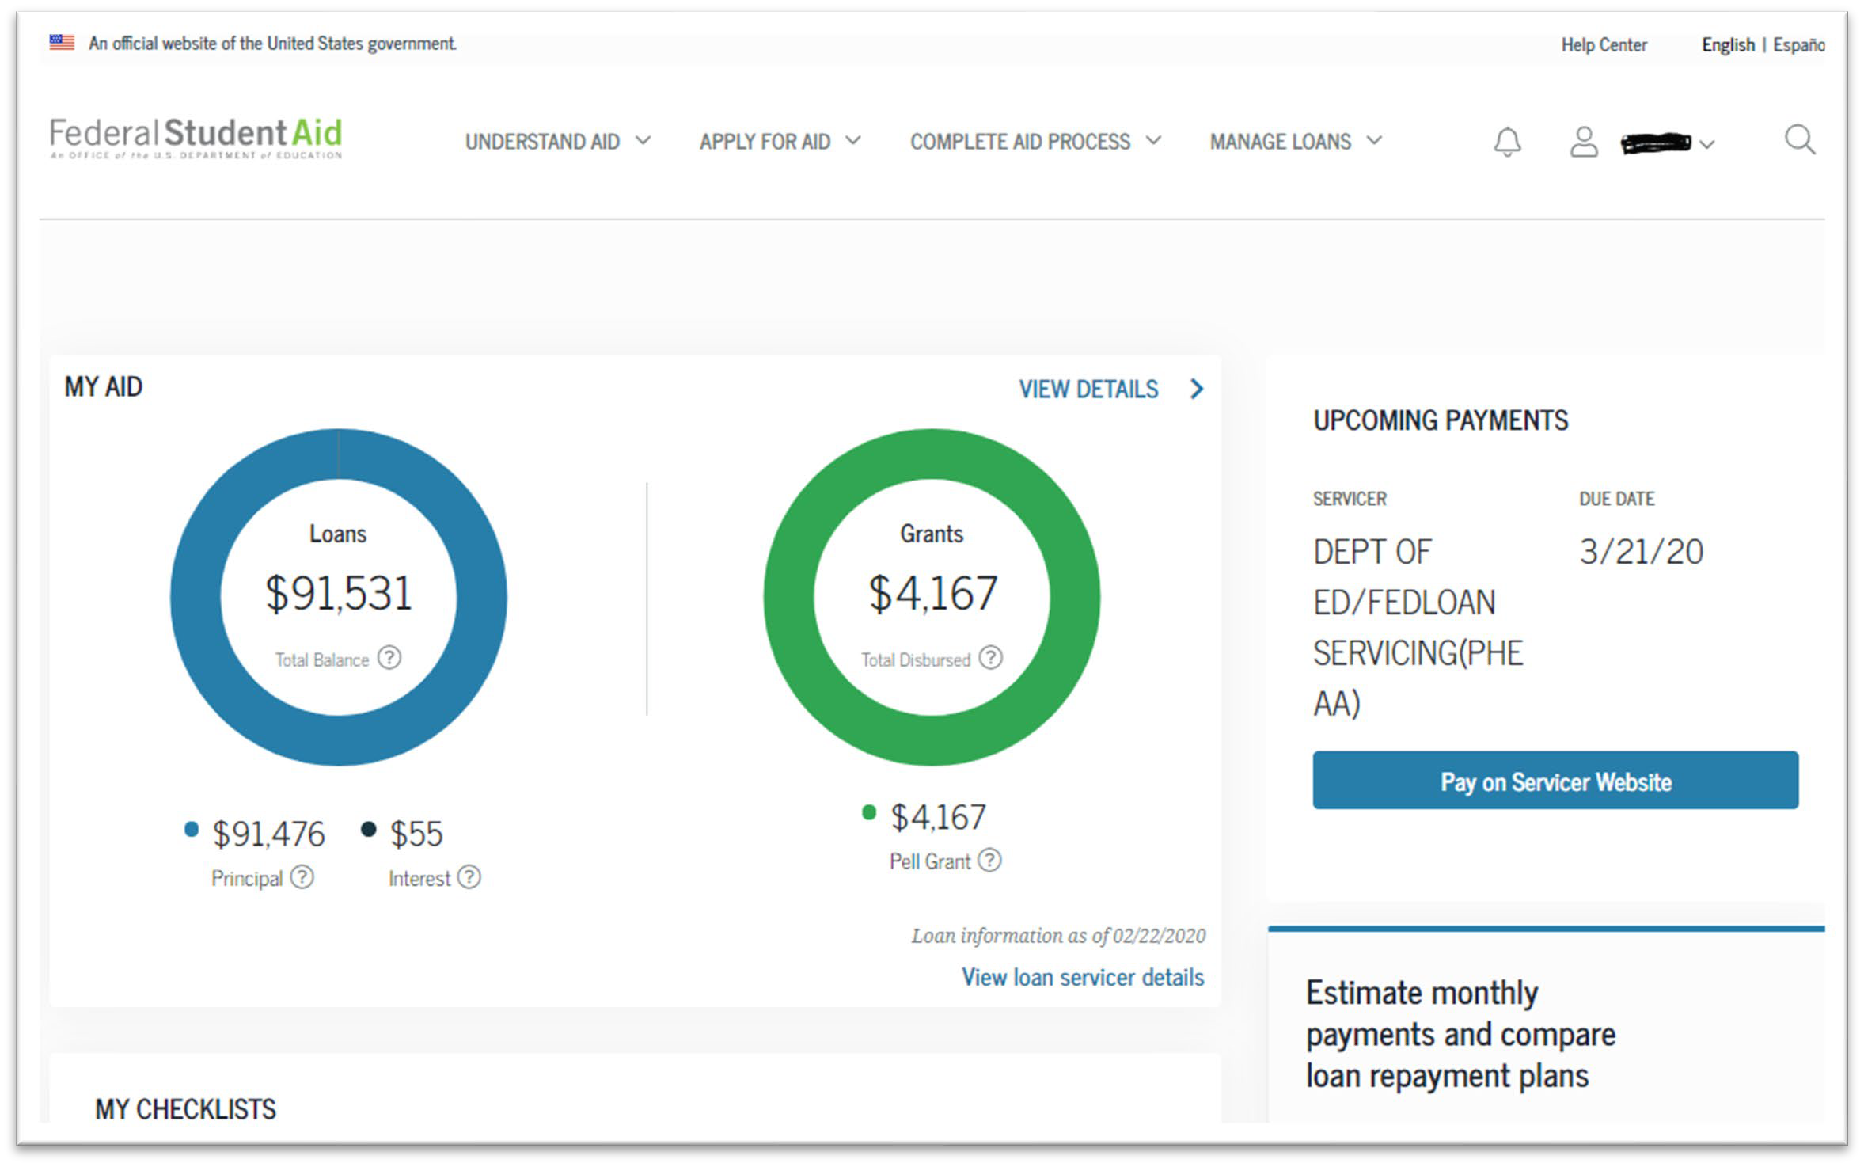
Federal Student Loans Overview Page
31

Slide 32
When things go wrong

Slide 33
Resolving Issues
If you don’t get a response or get a response you disagree with, you can escalate by filing a complaint to DOE’s Ombudsman Group through their Online Feedback Center by calling 877-557- 2575.
You can also submit a complaint to your servicer and in NYS to the Department of Financial Services: dfs.ny.gov/complaint.
Contact us! We may be able to help. If you recently got rejected for PSLF, you may be eligible for Temporary Expanded PSLF.

Slide 34
Student Loans: Most Common Mistakes

Slide 35
Most Common Mistakes Borrowers Make
Not having a strategy to tackle debt
Without a strategy, clients may not be taking advantage of all the options available to them within the federal student loan system. They may pay more and for longer than is necessary. EDCAP works on developing short and long-term strategies tailored to the clients’ needs.
Not knowing repayment options
The federal student loan system is complex but offers different options for struggling borrowers to make affordable payments and keep their loans in good standing. EDCAP can help clients identify and enroll in these plans and programs.
Overuse of deferment and forbearance
Not recertifying Income-Driven-Repayment (IDR) plans on time

Slide 36
Most Common Mistakes Borrowers Make, (Cont’d)
Misunderstanding forgiveness and discharge programs
One of the unique features of the federal student loan system is that it offers different paths to loan forgiveness. But the requirements of the various programs are difficult to understand and approval rates have been dismal. EDCAP works with clients to keep them on track towards successfully achieving loan forgiveness.
Improper consolidation
Taking on too much debt
When does the cost of education exceed the benefits? This is a difficult conversation that parents and students are increasingly having. EDCAP helps individuals and families do the research required to get the most out of their education dollars spent!

Slide 37
Most Common Mistakes Borrowers Make, (Cont’d)
Parents/Caretakers risking their own financial security
Avoiding loans until it’s too late (going into default)
It takes almost nine months to go into default in the federal student loan system. It can be avoided and/or cured if it does happen. EDCAP teaches clients how to avoid default and can get them out if default has already occurred.
Lack of record keeping
Falling for student loan scams
Scams are prolific! You should never have to pay for student loan help. Know the players. Get help from the loan servicer, private lender or a credible consumer advocate program like EDCAP!
Not asking for help

Slide 38
What’s next? The importance of reaching and educating consumers.

Slide 39
Updates for 2022
Post-COVID Payment Resumption. Federal student loan payments will restart after January 31, 2022. Payment Restart Factsheet
Loan Servicing Changes: Three loan servicers managing 15.5 million borrowers will be leaving the federal loan servicing business in 2022. 35% of borrowers will face a change in their servicer.
FedLoan’s Departure: FedLoan is the student loan servicer in charge of managing the Public Service Loan Forgiveness Program (PSLF). They will stop servicing federal loans by the end of 2021. FedLoan’s Departure Factsheet
Public Service Loan Forgiveness: Temporary Relief. The federal government is temporarily waiving key requirements of the PSLF program until October 31, 2022. PSLF Waiver Factsheet

Slide 40
Questions?
Contact Us:
By email: edcap@cssny.org By phone: 1-888-614-5004
Web: edcapny.org

Slide 41
Additional Information

Slide 42
Not Having a Strategy To Tackle Your Debt
Without a strategy clients may not be taking advantage of all the options available to them and either pay a lot more and/or live with the debt for years longer than is necessary!
EDCAP works with clients to develop short and long-term strategies tailored to their circumstances.

Slide 43
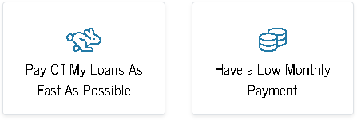
Not Having a Strategy, (Cont’d)
Determine income and expenses and payment priorities.
Most people choose one of two paths:
Are they eligible for loan forgiveness?
Do they have the right repayment plan?

Slide 44
Not Knowing Repayment Options
The Standard Plans: Payments are based on size of loan, interest rate and pre-determined payback period.
10-30 Year Fixed or Graduated Plans
Income-Driven-Repayment (IDR) Plans: Payments and payback period are based on your Adjusted Gross Income and family size.
Revised Pay As You Earn (REPAYE)
Pay As You Earn (PAYE)
Income Based Repayment (IBR)
Income Contingent Repayment (ICR)
If you can’t afford payments in the Standard plans, ask for an IDR option!

Slide 45
Overuse of Deferment and Forbearance
Deferment and Forbearance offer short-term payment relief (up to one year). But…
Periods spend in Deferment and/or Forbearance, in most cases, DO NOT QUALIFY for forgiveness programs. And…
Unpaid interest balances will capitalize (be added to your principal) every time your Deferment or Forbearance expires.
Excessive use of these tools can lead to unnecessarily high loan balances and lost-opportunity in achieving loan forgiveness.
Enrolling in an IDR plan is often the better long-term strategy.

Slide 46
Not Recertifying IDR Plans Ontime
Income-Driven-Repayment (IDR) plans calculate payments based on income, family size and tax-filing status and often provide an affordable alternative to Standard Plans. But…
IDR plans must be recertified annually!
This can be done online at student aid.gov or with the loan servicer!
Missing a recertification date has consequences:
Payments may increase dramatically
Unpaid interest balances will capitalize
Borrower may be removed from the plan and re-entry may require making several high payments.
Don’t miss the deadline! Servicers send notifications several months in advance of upcoming recertification dates.

Slide 47
Misunderstanding Forgiveness and Discharge Programs and their Requirements
Public Service Loan Forgiveness (PSLF):
Make 120 qualifying payments (10 Years) and unpaid balances will be forgiven WITHOUT TAX CONSEQUENCE!
You must have Direct Loans
You must be enrolled in an Income-Driven-Repayment (IDR) plan
You must be employed full time by a qualifying employer (501c(3) and other kinds of non-profits, governmental agencies, AmeriCorps or Peace Corps)
Make your required payment in full and on-time
Income-Driven-Repayment (IDR) Forgiveness:
Make required payments while enrolled in an IDR plan for a period of time (20-25 years) and unpaid balances will be forgiven.
There are no employment requirements in this program.
Forgiven balances MAY BE TAXABLE!

Slide 48
Improper Consolidation
Consolidation can be useful if done correctly. It can:
Cure a default.
Expand repayment options.
Make loans eligible for forgiveness programs—i.e., FFEL loans must be consolidated to Direct loans for those loans to qualify for PSLF.
Make it administratively easier by tracking fewer loans, payments, and forgiveness/discharge eligibility.
But if consolidation is not done strategically, it can be harmful:
Consolidating a loan resets the qualifying payment count clock for IDR and PSLF forgiveness.
Combining certain types of loans may limit your repayment options.
Get help before you consolidate. Call EDCAP!

Slide 49
Taking On Too Much Debt
When does the cost of education exceed the benefits?
Clients should ask themselves these questions:
Does the school they’re attending have a good track record of graduating students and at what rate do graduates find employment?
What are people in their field of study earning on average?
What are the monthly payments on their student loans going to be when they graduate?
How long will it take them to pay off the loans?

Slide 50
Taking On Too Much Debt, (Cont’d)
Questions, (Cont’d):
Are there forgiveness programs available for student debt borrowers in their chosen occupation?
Will the cost of the student loan payment prevent them from pursuing other big life goals like purchasing a home or starting a family?
Do research before taking on the debt. Go local to maximize State aid and reduce living expenses.

Slide 51
Parents/Caretakers Risking Their Own Security
Private Loan Co-Signers:
Most private student debt is going to require a co-signer.
Co-signers are 100% liable for this debt if the primary borrower does not pay and repayment options are limited.
Though it is difficult to discharge private student debt in bankruptcy, statutes of limitation do apply.
Being released from the loan is up to the lender and it is very hard to do.
Caution: Lenders will tell borrowers that you can easily be released as a co- signer once the student borrower starts working and that is often not the case.

Slide 52
Parents/Caretakers Risking Their Own Security, (Cont’d)
Parent Plus Loans: Are easy to get, not always easy to pay off!
Parents can borrow up to the Cost of Attendance less any financial aid the student receives. Only a credit check is required.
Interest rates are higher than loans to students and repayment options more limited.
Parents Beware! These are their loans and cannot be transferred back to the student!
Know what you’re getting into. Make sure they can afford the payments. Do a budget!

Slide 53
Avoiding Loans Until It’s Too Late
It’s not that easy to default on a federal student loan!
For Direct and FFEL loans, it takes 270 days (9 months) of non- payment before being at risk of default. (Perkins loans may default more quickly).
Defaulting has serious consequences:
The client may be subject to wage garnishment, tax refund intercepts or benefits offsets (i.e., Social Security).
They will lose access to federal student aid
Derogatory remarks are placed on their credit reports for 7 years.
There is no Statute of Limitations on federal student debt!
Explore options before you get there! Defaults can be avoided by enrolling in a more affordable IDR plan or asking for temporary deferment or forbearance.
Defaults can be cured. Contact EDCAP for help!

Slide 54
Lack of Record Keeping
Mistakes Happen! The best way to dispute them is if you have the records to prove your case.
Download/Print/Keep the following from your loan servicer:
Loan details (Type of loan, outstanding balance, interest rates)
Payment & billing history.
Qualifying payment count towards PSLF (FedLoan).
Certification and Applications you have filed.
Federal Student Aid (FSA) may be a source for some of this information as well.
Keep payment records from your bank. .
This is always good practice but is particularly important for FedLoan, Granite State and Navient customers right now.

Slide 55
Falling for Student Loan Scams
You never have to pay for help with your student loans!
A third-party company that tries to charge you for services related to your student loans is the first sign of a scam. They may offer to:
Enroll you in a “new forgiveness program before it’s too late”
Consolidate your loans
File Certifications and Applications
Know The Players:
The U.S. Department of Education (D.O.E.) establishes the rules for ALL federal student loans. Their official website is Federal Student Aid (FSA) studentaid.gov
Loan Servicers administer federal student loans. They send bills, collect payments, process applications and more.
The Private Student Loan lender is the financial institution that issues private loans.

Slide 56
Falling for Student Loan Scams, (Cont’d)
If the client isn’t sure who their federal student loan servicer is, you can find that information by logging into their FSA account with their FSA ID. Or you can call FSA at 1-800-433-3243.
Federal Student Loan Servicers | Phone Number | Note
ECSI | 1-866-313-3797
FedLoan Servicing (PHEAA) | 1-800-699-2908 | Exiting servicing business
Granite State-GSMR | 1-888-556-0022 | Exiting servicing business
Great Lakes Educational Service | 1-800-236-4300
HESC/Edfinancial | 1-855-337-6884
MOHELA | 1-888-866-4352
Navient | 1-800-722-1300 | Exiting servicing business
Nelnet | 1-888-486-4722
OSLA Servicing | 1-866-264-9762
To identify a private lender, check personal records, run a credit report or contact the school.

Slide 57
Not Asking For Help
Ignoring student loans won’t make them go away. The federal student loan system is complicated and difficult to navigate.
If you’re struggling, there are options.
Keep loans in good standing. Protect your credit and financial security. HAVE A PLAN!
EDCAP can help! Contact Us:
By email: EDCAP@cssny.org
By phone: 1-888-614-5004
Website: edcapny.org

